Slide 1
NSERC Fall Workshop
We acknowledge that we live and work on Treaty 6 Territory and the Homeland of the Métis. We pay our respect to the First Nations and Métis ancestors of this place and reaffirm our relationship with one another.
~ Please note: this workshop is being recorded.
1:30 – 1:40 PM Welcome, Merit Grid and Ratings Reminders – Ron Borowsky
1:40 – 2:00 PM Research Portal and CCV – Heidi Smithson
2:00 – 2:20 PM Equity Diversity and Inclusion – Tera Ebach
2:20 – 2:30 PM UnivRS Submission/compliance review - Brenda Meyer-Burt
2:30 – 3:00 PM Q & A

Slide 2
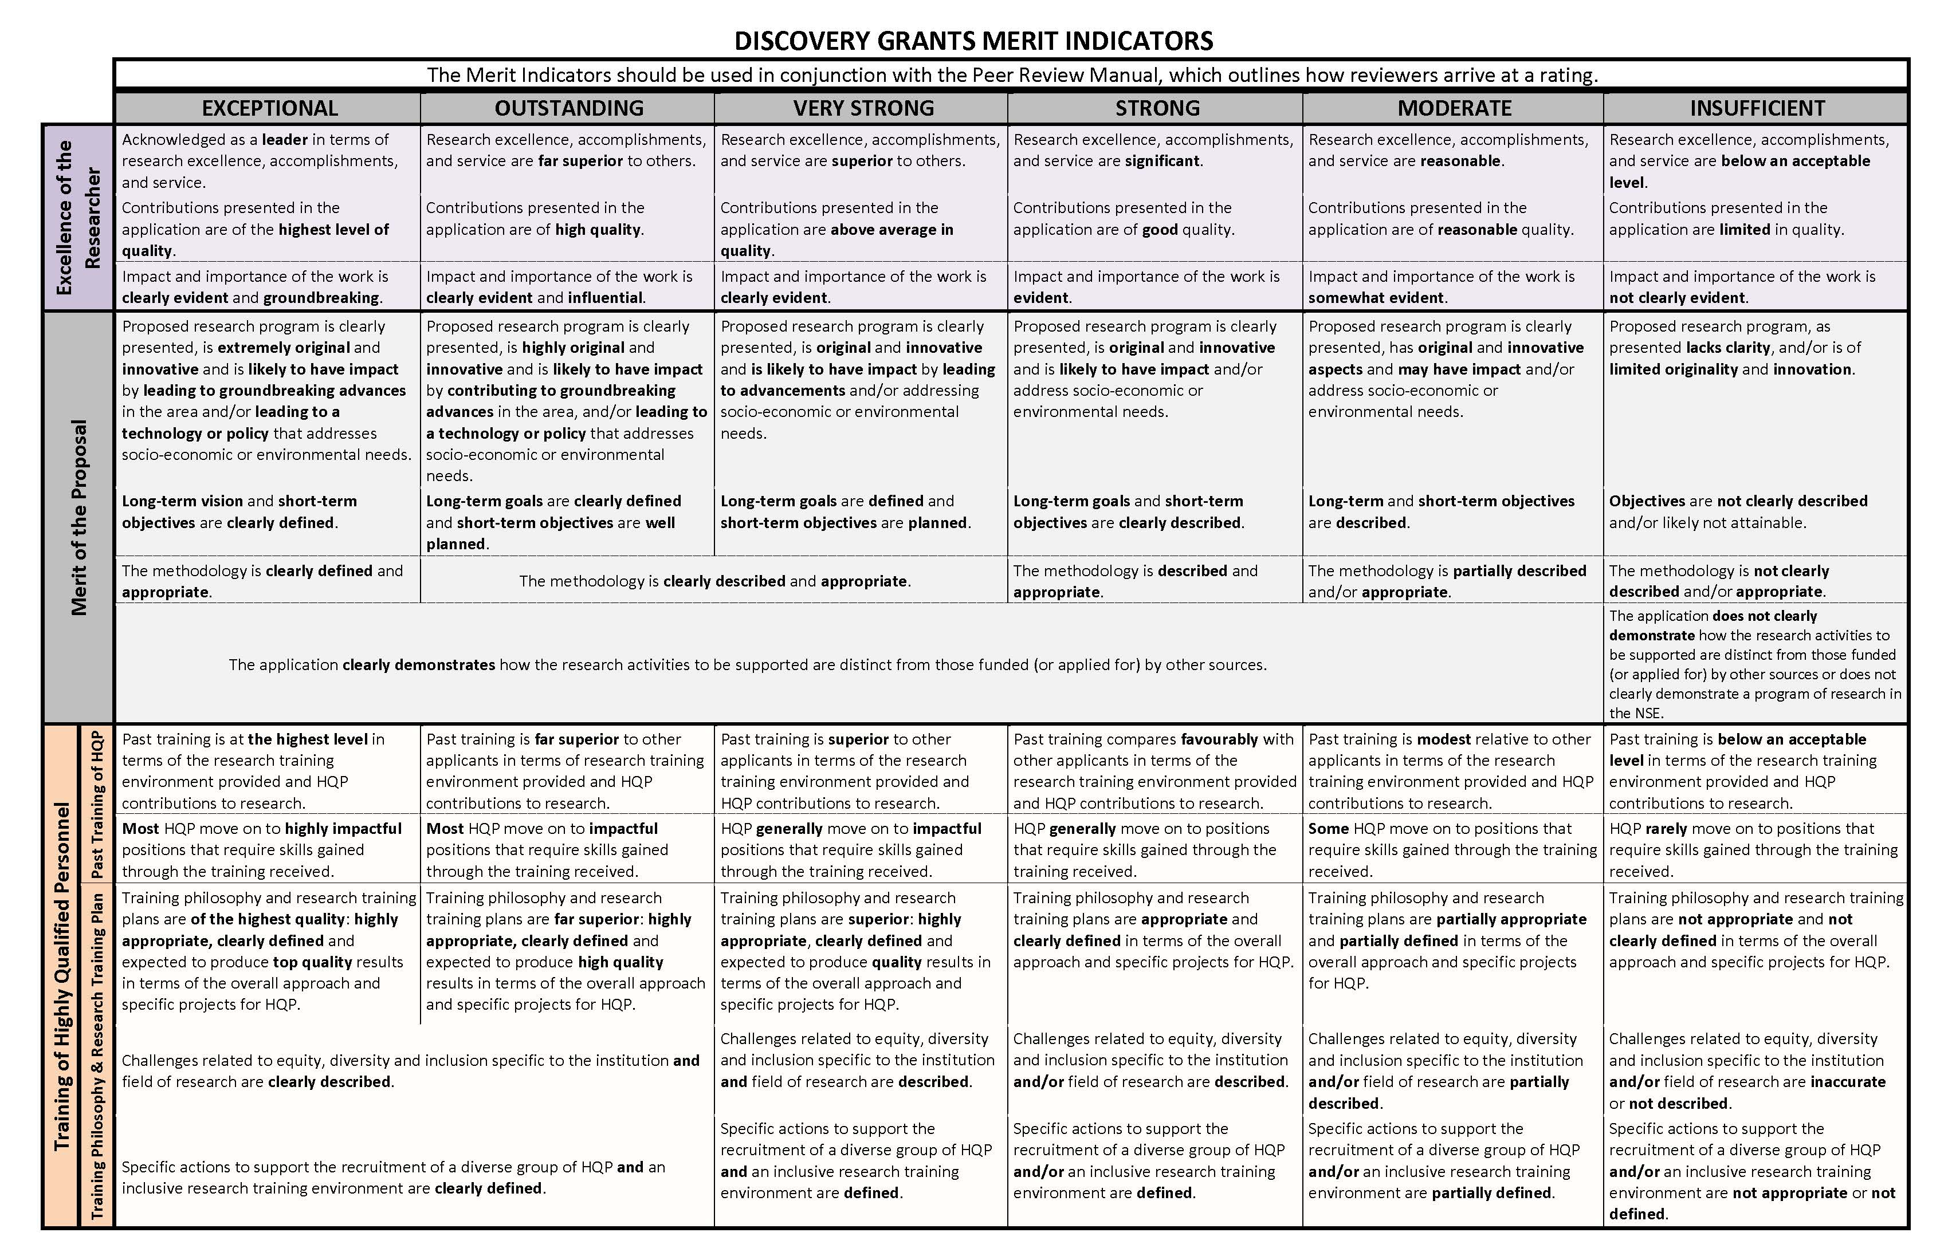
The Merit “Grid”

Slide 3
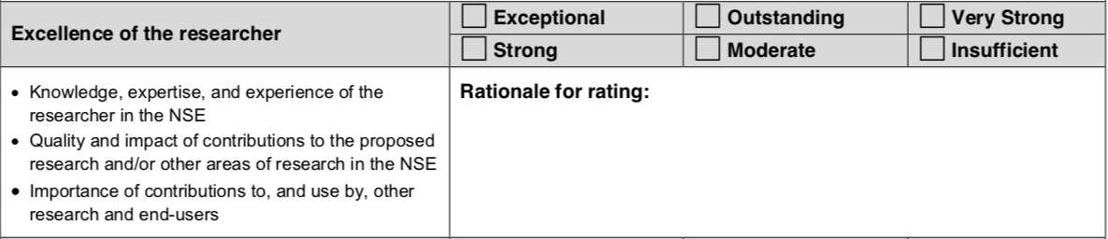
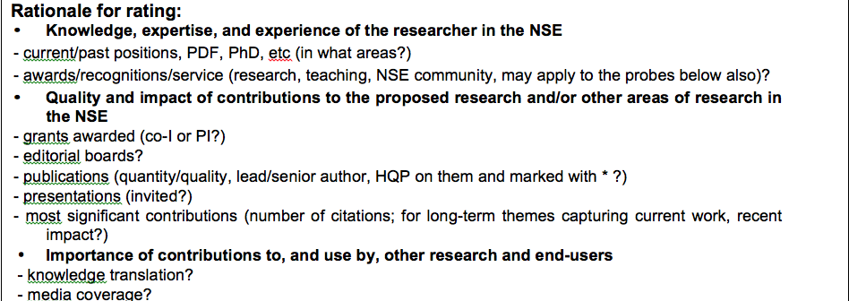
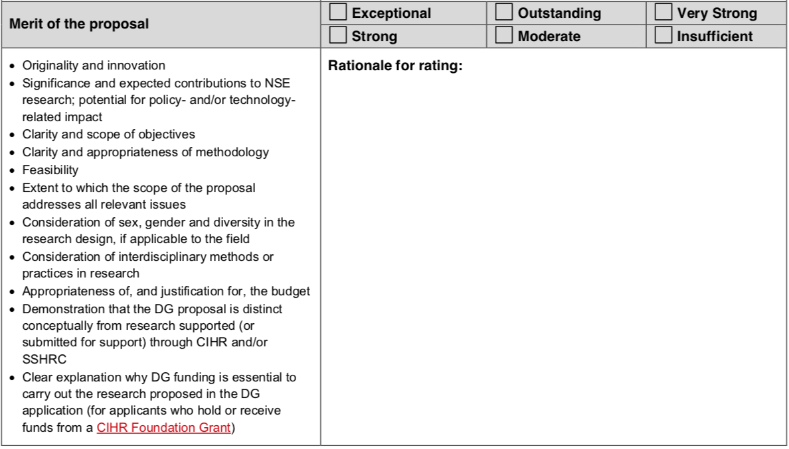
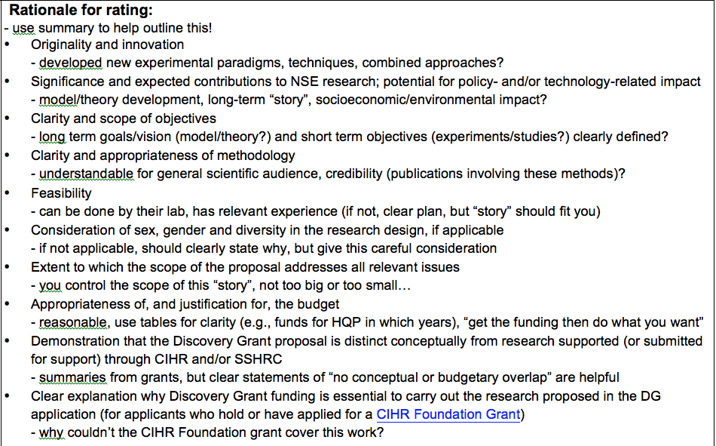
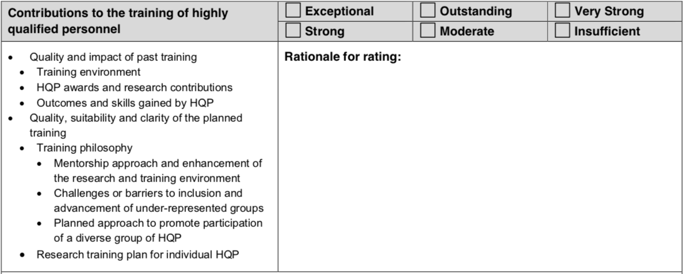
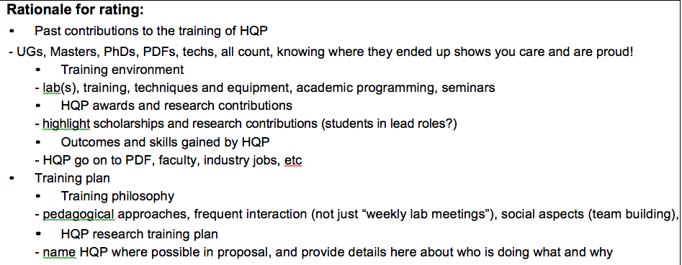
NSERC DG Rating Form – Ron Borowsky
Now “where”
￼
EDI of HQP! (see slides from our next 2 presenters)

Slide 4
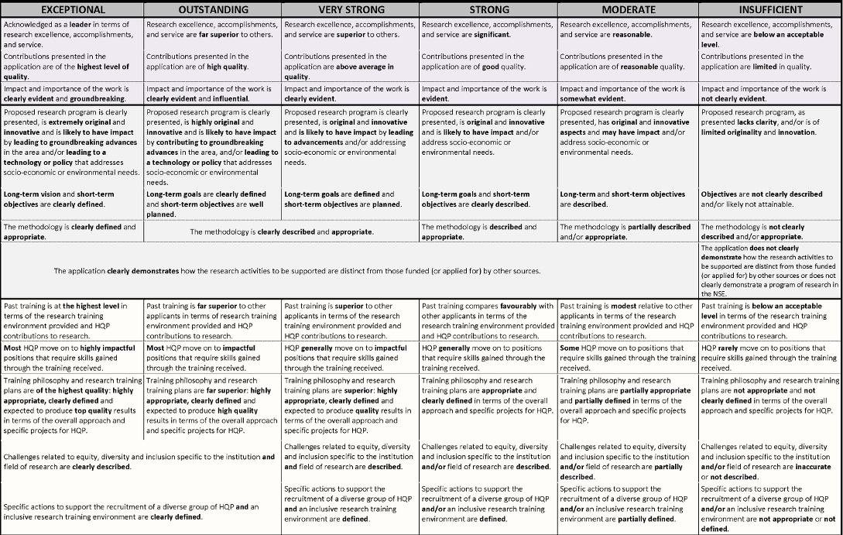
Excellence of Researcher

Slide 5
Merit of the Proposal

Slide 6
Training of HQP
EDI of HQP! (see slides from our next 2 presenters)

Slide 7
Top Tips for CCV
Start Early!
Use the NSERC CCV template (under Funded on the CV tab)
Follow the PDF Guide provided by NSERC in the NSERC template
Make good use of extra space
Mark your HQP with asterisks following their surnames
Visit the Grants Repository to see samples of CVs from past successful applications (https://vpresearch.usask.ca/events/grants-calendar.php)
Contact your RF or RASI with questions or issues
Attend the fall CCV and DG application clinic (dates and times will be announced later in the summer).

Slide 8
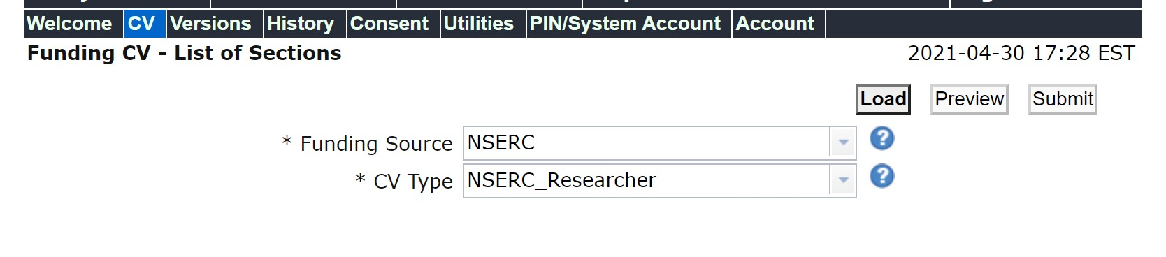
Use the NSERC CV Template
To select the NSERC CCV template, choose ‘Funded’ under the CV tab, search for NSERC under funding source, then select NSERC_Researcher for CV Type.

Slide 9
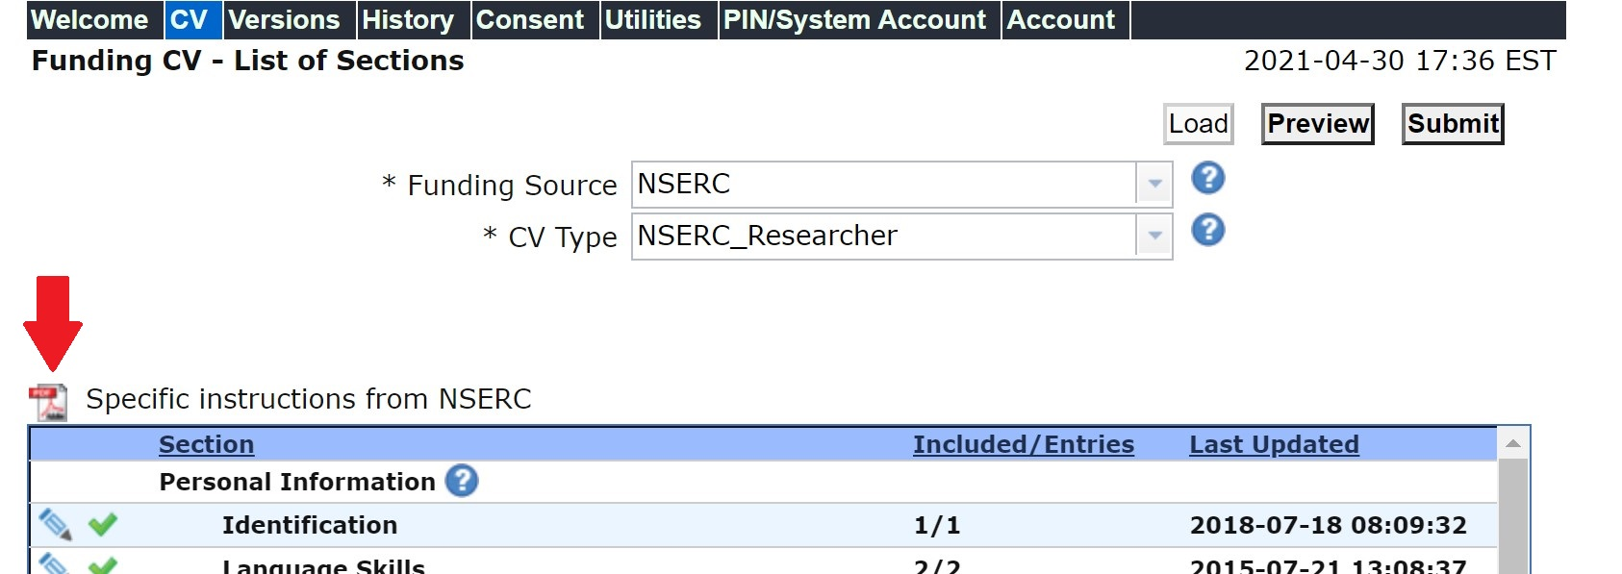
Follow the PDF provided by NSERC

Slide 10
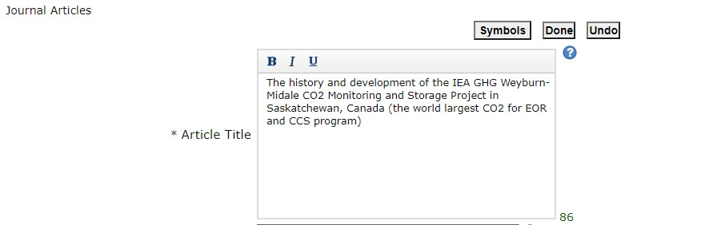
Make good use of extra space
Note that many of the text boxes in CCV have a lot of space. You can use this space to provide additional information about entries (e.g., award received for a paper, etc.)

Slide 11
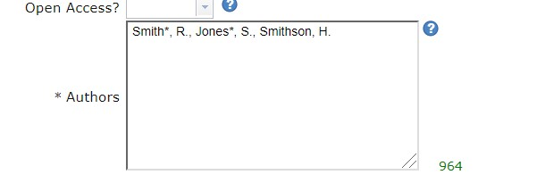
Mark your HQP with asterisks following their surnames

Slide 12
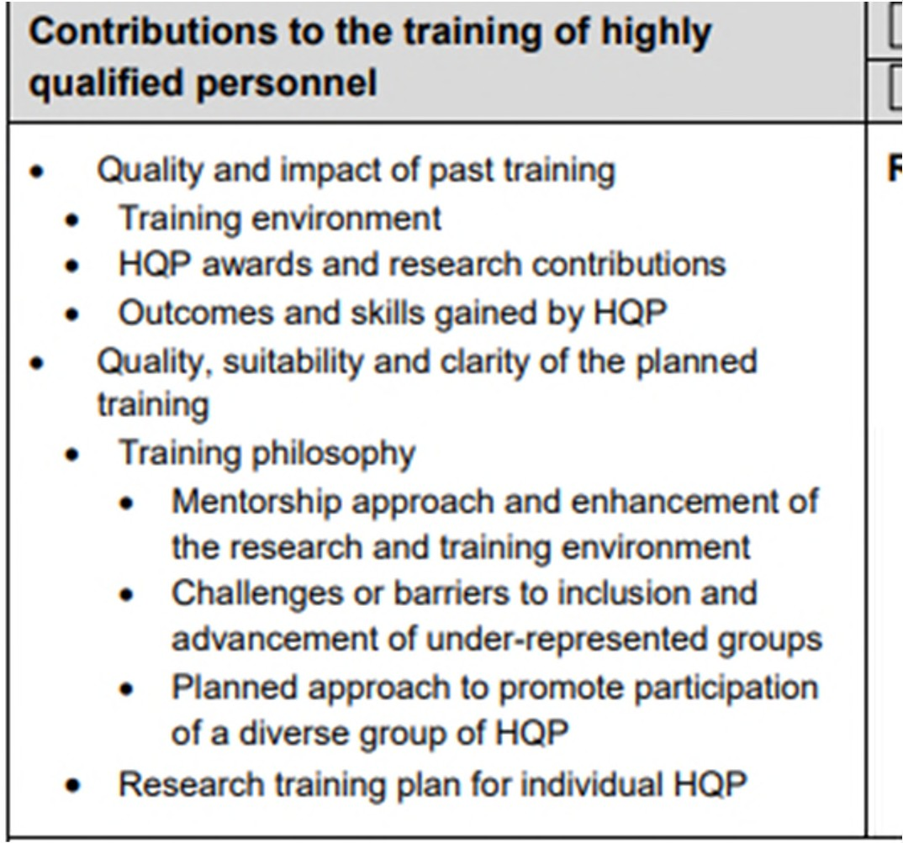
Equity Diversity and Inclusion (EDI)Discovery Grants Merit Indicators
www.usask.ca

Slide 13

Equity Diversity and Inclusion (EDI) on Discovery Grants
Institution or College EDI challenges
Field of Research EDI challenges
USask commitments for EDI recruitment that address Institution challenges
Include your own specific EDI recruitment practices that address both USask and discipline EDI Challenges.
USask resources for an Inclusive research training environment that address EDI challenges.
Include your own specific training plan practices that address USask and Field EDI challenges
Sex and Gender in research design
www.usask.ca

Slide 14
EDI challenges for the institution
Accessing information available on the RASI website
Work with facilitators and EDI specialists
USask priorities include Indigenization (Embrace Manacihitowin)
Systemic barriers NFRF information
The 2018 report published by the Canadian Association of University Teachers, Underrepresented and Underpaid: Diversity & Equity Among Canada’s Postsecondary Education Teachers, highlights the persistent lack of diversity in the academic workforce, and wage gaps between men and women, and between white and Indigenous and racialized staff.
www.usask.ca

Slide 15
EDI challenges in discipline
Contact Research Facilitator for College and EDI specialist
Example Association website Engineering – Enrollment of women
COVID-19 affecting diversity in Science
www.usask.ca

Slide 16
Specific actions for recruiting a diverse HQP group
What is USask doing to address institutional Challenges
What specific action item can you include to address institutional challenges?
In your discipline, what specific action can you take to address this challenge for recruitment?
www.usask.ca

Slide 17
Inclusive Research training environment
What resources does USask have that you can use to address EDI challenges in your training plan
What actions can you take to address the EDI challenges in your discipline in your training plan
SMART EDI plans -Specific Measurable Achievable Relevant and Time-Bound
www.usask.ca

Slide 18
Sex and Gender in Research Design
Rationale and methodology for including sex, gender and diversity in the research design are clearly described; and
Aspects of sex (biological), gender (socio-cultural) and diversity are addressed in the research design, making it more ethically sound, rigorous and useful
www.usask.ca

Slide 19
Example Alliance-EDI plan for application
Team members and new students will complete USask’s unconscious bias training. Specific action item can be evaluated.
The Association showed that a high percentage of the students identify as white. My research group is committed to counteracting this systemic bias. We direct candidates to visit Dr. X’s research group webpage. A statement on EDI is posted, and previously recruited GS cited the importance of this approach and how it enabled them to apply for their positions. As part of the recruitment process, we will seek HQP candidates from visible minorities through social media campaigns and working with professional associations for minority groups such as the American Association of field Latin group. Data from the field and a specific issue they are addressing in and plan for PI to address issue.
Lab keeps a code of conduct on the lab website to promote an inclusive environment and regularly meets (as a group and individually) to address any emerging issues related to member mental health and work progress. To support students' participation in lab and social events, child-friendly venues, flexible work hours, diverse dietary choices, support to attend conferences, and student stipend above the suggested minimum are arranged. As role models for students, we support them through the discriminatory challenges that our team members have faced in their careers. Specific action items.
www.usask.ca

Slide 20
Resources
NSERC EDI guide for applicants-https://www.nserc- crsng.gc.ca/_doc/EDI/Guide_for_Applicants_EN.pdf
NFRF EDI https://www.sshrc-crsh.gc.ca/funding-financement/nfrf-fnfr/edi- eng.aspx#3
RASI EDI https://vpresearch.usask.ca/rasi/resource-hub/edi-equity-diversity- inclusion.php
EDI- Recruitment https://jira.usask.ca/servicedesk/customer/kb/view/1346961465?q=Equity%2C+Div ersity%2C+and+Inclusion+%28EDI%29+in+Recruitment
EDI Framework-https://www.nserc-crsng.gc.ca/NSERC-CRSNG/EDI- EDI/framework_cadre-de-reference_eng.asp
www.usask.ca

Slide 21
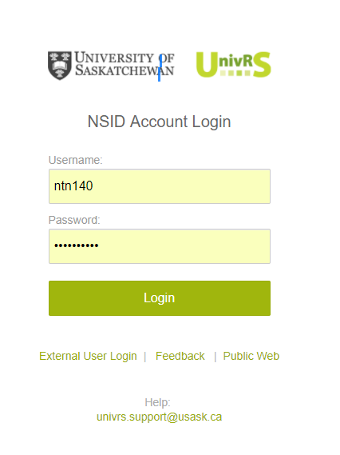
Submitting Discovery/RTI Applications
Discovery Grant applications must be submitted via UnivRS for Review and Approval
Submit a copy of your complete Discovery application, including your CCV for review and approval.
RASI Internal Deadline for review and approval is
RTI – Oct 18th
Discovery Grant - Oct 25th
Check with your Department/College to find out how many days they need for review and approval.
Application should be submitted in UnivRS 7-10 days before the agency deadline.
UnivRS – University Research System
Contact your Facilitator or Research Support Specialist for help with submitting your application in UnivRS.

Slide 22
Compliance Review
Your application will be reviewed to ensure it meets the agency requirements and follows Usask policies.
Research Support Specialist reviews your application and sends you feedback from the review.
Wait until you receive feedback and make your final revisions before submitting your application in the Research Portal.
Research Support Specialist | Email
Ronda Appell | ronda.appell@usask.ca
Nicole Benning | nicole.benning@usask.ca
Cameron Berg | cam.berg@usask.ca
Tera Ebach | tera.ebach@usask.ca
Brenda Meyer-Burt | brenda.meyer-burt@usask.ca
Laurie Schmipf | laurie.Schimpf@usask.ca

Slide 23
Common Compliance Issues
Don’t include demographic data in the Equity, Diversity and Inclusion sections of your application.
Use the headings and sub-headings provided for the free-form sections.
Provide details such as the rates for benefits, fees, per diem, mileage, rental, housing, etc. in your budget justification.
Follow the Research portal presentation and attachment standards.
Provide an explanation for all other research support that will be or may be active during the funding period of the Discovery Grant.
Update your CCV including the Research Funding History.

Slide 24
Some useful links:
NSERC guidelines for Impacts of the COVID-19 pandemic on research:
  https://www.nserc-crsng.gc.ca/NSERC-CRSNG/Policies-Politiques/COVID-COVID_eng.asp
Equity, diversity and inclusion considerations at each stage of the research process:
  https://www.nserc-crsng.gc.ca/NSERC-CRSNG/Policies-Politiques/EDI_guidance-Conseils_EDI_eng.asp
NSERC DG and RTI Evaluation Groups:
  NSERC - Committees - 1557 - Synergy Awards for Innovation and Innovation Challenge Awards Selection Committee (nserc-crsng.gc.ca)

