Slide 1
Canada foundation for innovation (CFI)
2
+
2
+
2025 Innovation Fund (IF)
Presented by RASI, October 2023
Slides will be shared following the presentation

Slide 2
Land Acknowledgement
2
+
As we gather here today, we acknowledge we are on Treaty 6 Territory and the Homeland of the Métis. We pay our respect to the First Nations and Métis ancestors of this place and reaffirm our relationship with one another.

Slide 3
outline
2
+
Competition at a glance
Assessment criteria
Competition timeline
Next steps & available help
Q&A

Slide 4
CFI-IF at a Glance
2
+
Supports innovative research programs by investing in infrastructure
Objectives:
Enable global leadership by supporting world-class research or technology development.
Enhance and optimize the capacity of institutions and research communities to conduct the proposed research or technology development program(s).
Lead to social, health, environmental and/or economic benefits for Canadians.

Slide 5
CFI-IF Opportunity
2
+
“Achieve Your Research Goals With State-Of-The-Art Infrastructure”
Possibilities:
Acquire state-of-the-art equipment (e.g. robot samplers, MRIs, animal housing units, advanced microscopes, high-performance computing, etc.)
Renovate and modernize a current space to be what you need it to be (or multiple spaces on or across campuses)
Build a completely new building for your research needs

Slide 6
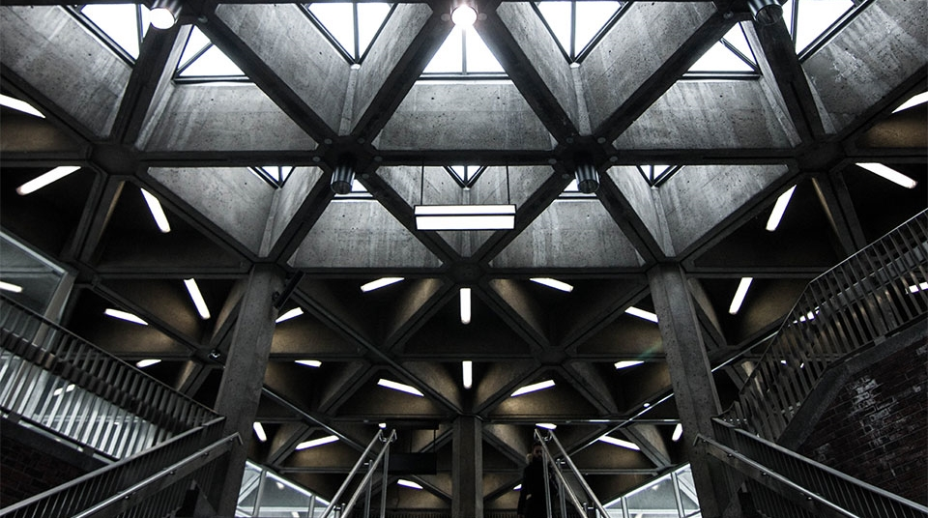
2
+
Funding: anticipated
CFI total ~$400M in research infrastructure
Up to 40% of total eligible cost
Project must be greater than $1 million
USask envelope $15-20M
USask will not overprescribe the envelope
Envelope is not guaranteed, as we compete nationally
USask has a record of successful applications in both the 2023 and 2020 competitions

Slide 7
2
+
Innovation Fund: By the Numbers
Out of the proposals submitted to the expert committees, there was a 34% success rate in the 2023 IF competition
100 out of 297 Awarded
2020 Academic Categories:
Engineering = 40%
Health = 37%
Science = 16%
Environment = 6%
Social Sciences and Humanities = 1%

Slide 8
Assessment criteria
2
+
2
+
Research or technology development
Innovative, feasible, and internationally competitive
Team
Up to 10 members, options for co-leads
Diverse with breadth of expertise
Research capacity
Past investments from Institutions and partners

Slide 9
Assessment criteria
2
+
2
+
Infrastructure
Necessity and appropriateness
Sustainability
Optimally used, operated, and sustained
Tangible commitments
Benefits
How will you transfer research results to end users?
What are the social, health, environmental, and/or economic benefits for Canadians?

Slide 10
Edi Assessment Criteria – Equity, Diversity, Inclusion
2
+
2
+
A key decision point in previous competitions (Pass/Fail)
Must prioritize EDI in the team composition, recruitment practices, research design, and accessibility (e.g. the balance of genders, career stage, college/departments, areas of expertise, racialized minorities, disabilities, etc.)
Required to identify the systemic barriers in your scientific discipline and develop strategies to mitigate those barriers
It is NOT ENOUGH to say that USask’s policies will be followed
Applicants must clearly show a strong commitment to and understanding of EDI and its importance in Research

Slide 11
CFI
USask
Expert Review
MAC/Special MAC
Research & Technology Development
Team Details
Major Comparators & Value-add of USask Investment
Institutional Track Record & Commitment
Equipment & Construction/ Renovations
Matching Funds
Sustainability & Operations
Benefits of the Project
Research or Technology Development
Team
Research Capacity
Infrastructure
Sustainability
Benefits
Global Leadership
Enhance Research Capacity
Benefits for Canada

Slide 12
2
+
Other key Considerations
+
Core facilities
Will it provide access to state-of-the-art services, instruments, expertise, and training?
Does not have to be
Matching funds
Think creatively and broadly about partners
Benefits to Canada
Benefits to SK (Provincial Pitch)
Enhanced research security (More info to come)
Identify potential security risks
Identify and implement measures to mitigate any identified risks

Slide 13
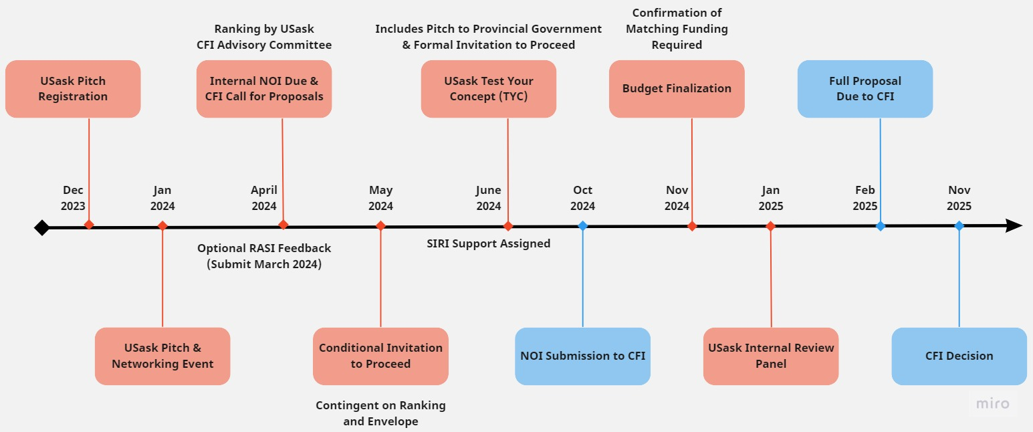
Timeline (Usask & CFI)

Slide 14
Next Steps
2
+
2
+
Register for the Pitch & Networking session by Dec. 1, 2023
Complete the registration form linked here
The link can be found on the RASI-CFI Website
Information Required:
Project title
Pitch members (Max 3) and associated colleges
Description of project (Research, Infrastructure Needed, Approx. Budget, Potential partnerships)
Registration information will be shared with the pitch panel in advance

Slide 15
January Pitch & Networking Session
2
+
Present project outline to Senior Leadership
10 minutes presentation
Panelists confirmed include:
Baljit Singh (Vice-President Research)
Brooke Milne (Dean, College of Arts & Science)
Terry Fonstad (Associate Vice-President Research - Ethics and Infrastructure)
What do I include in my presentation?
Who is the team? What is the research? What is the infrastructure? How is it unique? What are the benefits?
We will provide tips and more info closer to the event
This is optional but highly recommended
2
+

Slide 16
Internal Notice of Intent (NOI)
2
+
2
+
Due April 2024 (Due March 2024 for optional RASI feedback)
Consists of six sections:
Project Information (Title, Project Leader, Home College, etc.)
Project Summary ~ 1,500 characters
Collaborating Institutions
Team – identify 10 team members, including up to 2 team leaders
Anticipated costs and potential matching funding
Project Description ~ 4 pages
These sections will help you auto-populate the information into CAMS

Slide 17
Internal Notice of Intent (NOI)
2
+
2
+
The CFI Advisory Committee will review internal NOIs and rank them
Based on envelope and ranking, the selected projects will receive a conditional invitation to proceed
May 2024
Projects moving forward will have an opportunity to test-your-concept (TYC)
June 2024
Includes a pitch to the provincial government
Receive a formal invitation to proceed
Receive assigned RASI support – to help ensure a robust and competitive application

Slide 18
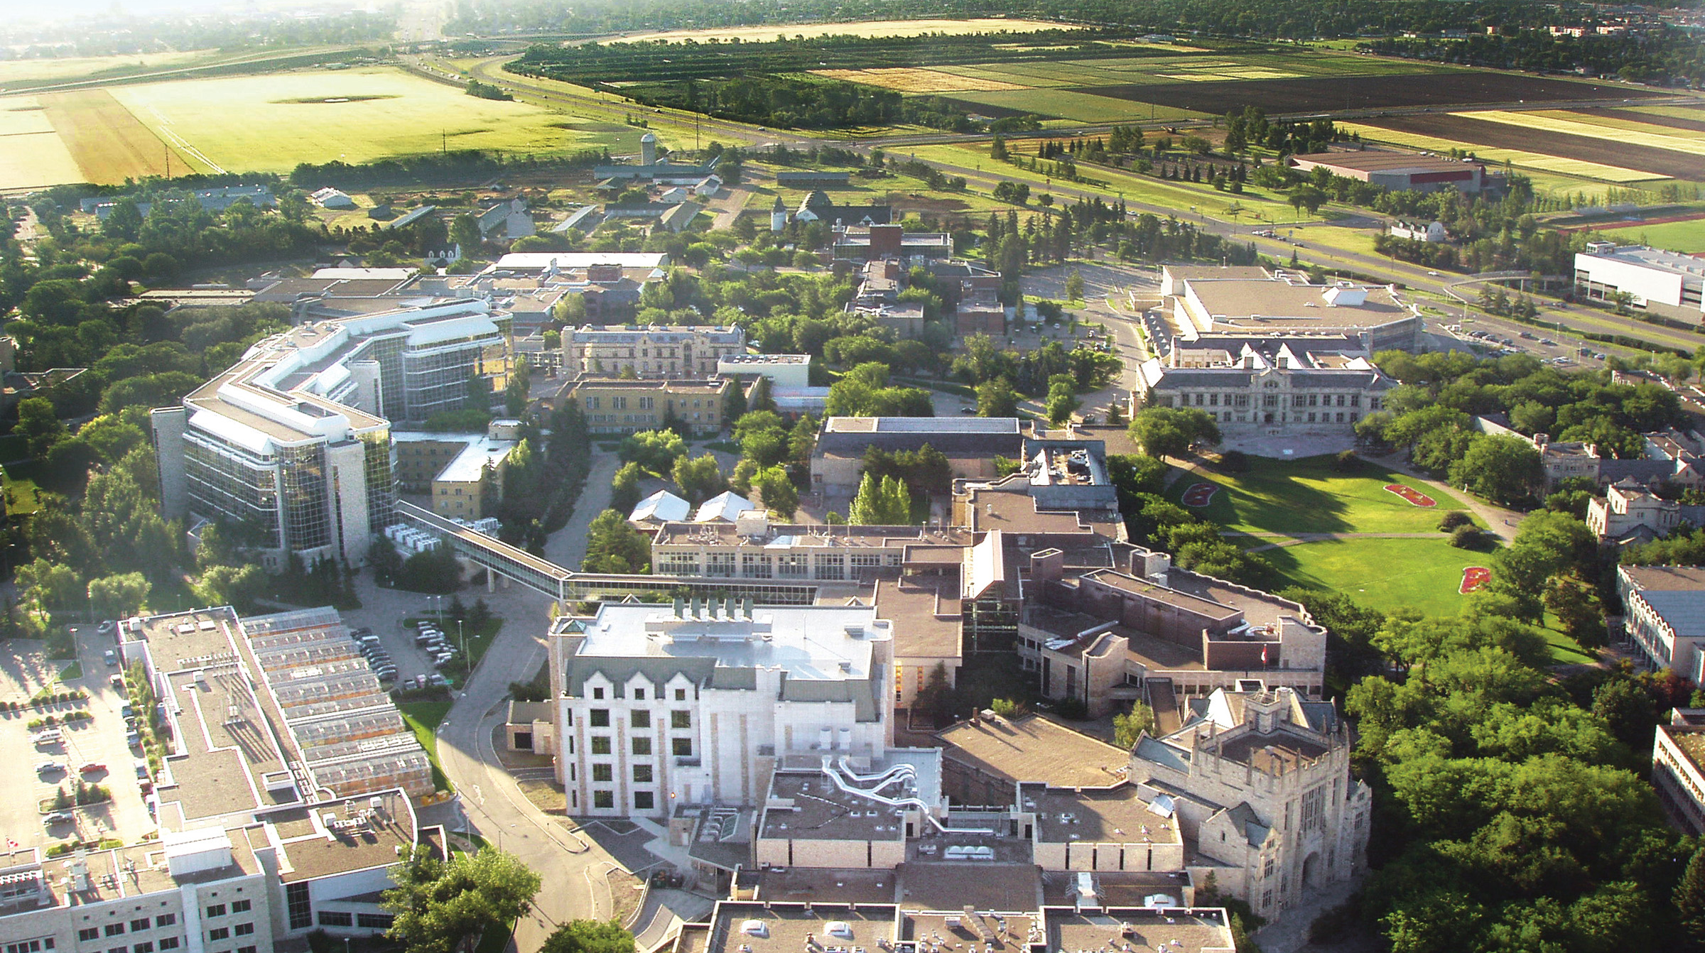
2
+
+
RASI is here to Assist
We are here to help and are happy to discuss your project ideas
Questions can be directed to rasi.support@usask.ca

Slide 19
Resources Complete the Pitch & Networking event registration form by Dec. 1, 2023 Please notify RASI if you are potentially participating in an IF project led by another institution CFI-IF webpage Detailed instructions at 2023 call for proposals - 2025 call likely released April 2024 Review 2020 Innovation Fund: By the Numbers - 2023 coming soon Review the 2021 EDI in the research infrastructure report
2
+

Slide 20
THANK YOU
2
+
2
+
Please contact RASI for more information,
or if you have any questions
rasi.support@usask.ca

