Slide 1
Demystifying an International Component in the Tri-Agency Funding Programs May 22, 2024 USask International Office​ Presenters: Le Li, Chantal Hanson, Leila Tang, Nataliia Zakharchuk​
Notes:
40 minutes + 20 minutes Q&A

Slide 2
Land Acknowledgement
The land is acknowledged as our Mother, the Earth. The University of Saskatchewan is committed to honor and support the *Indigenous peoples, Indigenous cultures, Indigenous values, and Indigenous languages that belong to the land of Treaty 6 Territory and Homeland of the Métis. The University of Saskatchewan is committed to working towards mending colonized lands and protecting the land in a way that demonstrates honour, respect, and love. The University of Saskatchewan extends this commitment to the lands and Treaty territories (Treaties 2, 4, 5, 6, 7, 8, and 10) that constitute kisiskâciwan ([Saskatchewan], “the swift current”, Cree/Saulteaux), and all Indigenous people that call kisiskâciwan home. We are born to the land and the land claims us..

Slide 3
Agenda
International Office team and the services we provide
Internal Grants for International Engagement
NSERC International
Horizon Europe
New Frontiers in Research Fund
Trans-Atlantic Platform for Social Sciences and Humanities
Panelists:
Dr. Lori Bradford
Dr. David Parkinson
Q&A

Slide 4
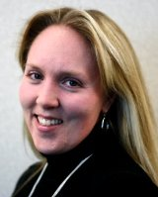
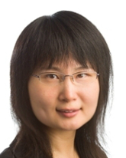
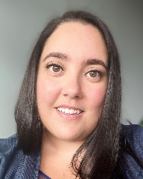
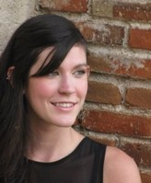
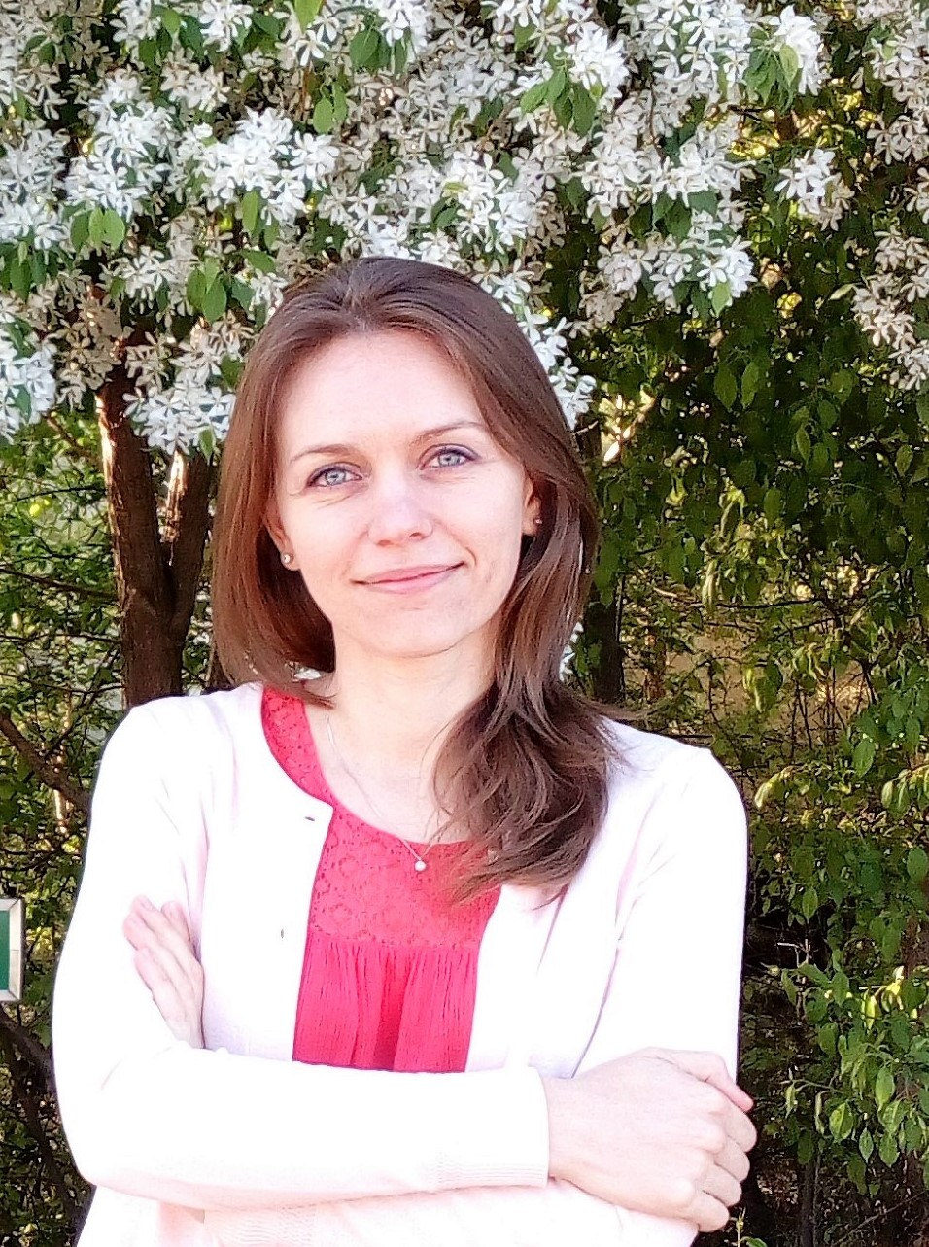
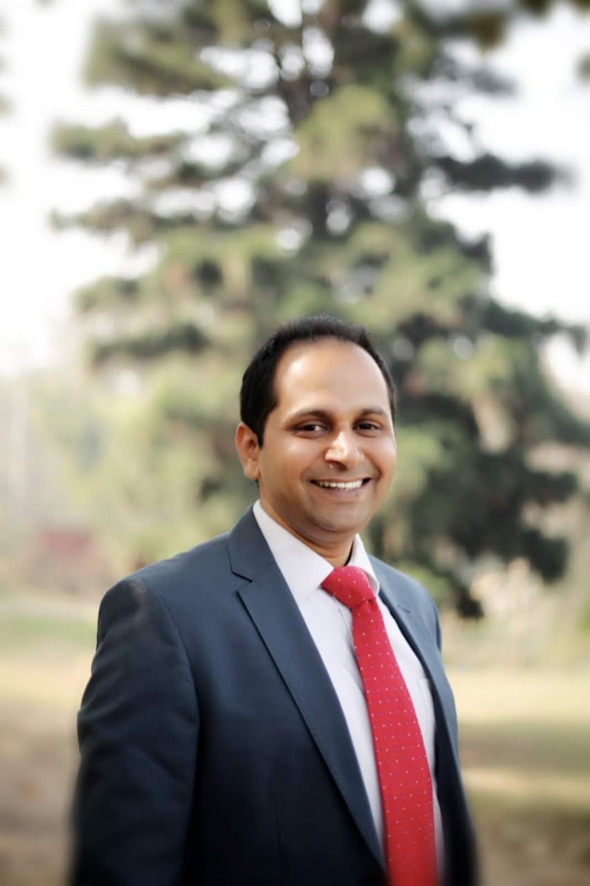
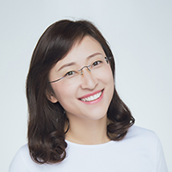
International Office Team
Dr. Meghna Ramaswamy
Director
Andrea Eccleston
Operations Manager
Le Li
Senior International Specialist
Vanessa Leon
International Partnerships Specialist
Chantal Hanson
International Research Specialist
Derek Tiessen
International Partnerships Specialist
Nataliia Zakharchuk
International Research Specialist
Arun Sharma
International Partnerships Specialist
Leila Tang
International Research Specialist

Slide 5
International Office Services
International Research Services
Collaboration path planning and outreach
Grant facilitation and development (internal and external international funding opportunities)
Compliance review and research administration
International Partnership Services
Institutional delegations / roundtable discussions
Agreement development and renewal -- MOUs, student exchange, dual/joint degree, consortium, etc.
International Information and Activity Services
Reporting of international metrics
USask Research Listservs

Slide 6
International Research Application Deadlines
The International Office procedure for international funding applications requires applications to be submitted to UnivRS and academically approved at least 10 business days prior to the funding agency’s external deadline. If an application is received in the UnivRS after this deadline, International Research Specialists may not be able to complete the compliance review in time and secure institutional approval for the submission to the external agency.
Operations Manager
Arun Sharma
International Partnerships Specialist

Slide 7
Internal Grants for International Engagement
International Travel Grants: One (1) competition per fiscal year; ~2-year window with minimum number of travel days/hours required for each program
Global Ambassador Program (Incoming) | USask faculty and Staff, up to $5,000
Global Ambassador Program (Outgoing) | USask faculty and Staff, up to $5,000
Internationalization Fund | USask faculty and Staff, up to $2,500
International Travel Award | USask faculty and Staff, up to $2,500
International Project Grants: One (1) competition per fiscal year; ~2-year project duration
Global Innovation Fund for New Partnership | USask faculty and global partners Up to $20,000
International Research Partnership Fund for Existing Partnership | USask faculty and global partners Up to $25,000
Global Community Service Fund: New Partnership | USask faculty and global partners Up to $20,000
Global Community Service Fund: Existing Partnership | USask faculty and global partners Up to $20,000
*All internal grants are posted on the International Office Internal Funding page, and through other USask channels: https://internationaloffice.usask.ca/internal-funding.php
**All internal grants are funded by the USask International Blueprint for Action 2025 (IB 2025 link)
Notes:
[Megan]
This is a quick snapshot of our Internal Grants for International Engagement broken down into two groups – International Travel Grants; and, International Project Grants.
International Travel Grants range from $2,500 to $5,000 and provide funding for travel to support various forms of partnership building activities with global partners. Grant activity can be for academic or research partnership building activities to travel to the partner institution. The Global Ambassador Program Outgoing, Internationalization Fund and International Travel Fund are for USask faculty or staff to travel to the international partner institution; and the Global Ambassador Program (Incoming) is for a USask faculty or staff to nominate an international partner to visit the USask and our research labs and campus here in Saskatoon.
International Project Grants are larger amounts of funding and range from $5,000 to $50,000. Project grants have specific parameters for each program— there's the Global Innovation Fund for New Partnerships between 10-50,000; International Research Partnership Fund for Existing Partnerships between $5-25,000, and the Global Community Service Fund with a stream for both new and existing partnerships, but please note the difference in funding for each stream New between 10,000 – 50,000 and existing between 5,000 – 25,000.
A competition for project and travel grants is typically held once per fiscal year, and both travel and project grants are about two-years in duration; so for the current competition, the start date can be as early as April 2022; with end dates of August 2024.
These grants are internal SEED funding opportunities, so it’s important to demonstrate throughout your proposal that the project will have potential to grow, scale and sustain past the end date of the grant. These grants are often used as leverage for other larger, external international funding opportunities.
All internal grants are posted on the International Office internal funding page with the website linked here in the presentation.

Slide 8
NSERC International
NSERC Alliance International
Catalyst stream: $20,000 to $25,000 for 1 year
Collaboration stream: $20,000 to $100,000 per year for 1-3 years
Collaborating with social sciences and humanity researchers is encouraged (30% of the project costs for these collaborations)
NSERC joint international calls
Example: NSERC + SSHRC + US National Science Foundation joint Call for Proposals for Global Centres on Bioeconomy
$500,000 per year for 4-5 years
Researchers from social sciences and humanities are highly encouraged to apply with or without natural sciences and engineering collaborators

Slide 9
Horizon Europe
The world’s largest research and innovation funding program - C$140 billion (2021-2027)
Canadians are eligible to apply for funding from some Horizon Europe opportunities (Pillar I and Pillar II)
Average grant size under Pillar 2: €3 million
Six clusters under Pillar 2:
Health
Culture, Creativity & Inclusive Society
Civil Security for Society
Digital, Industry and Space
Climate, Energy and Mobility
Food, Bioeconomy, Natural Resources, Agriculture & Environment

Slide 10
New Frontiers in Research Fund (NFRF)
NOI: August 27, 2024
Up to $125,000 per year
2-year projects
Vary each year according to the topic
LOI: January 10, 2024
Maximum $4,000,000 per year
6-year projects

Slide 11
Humanities and social science research funders from South America, North America, Europe & Africa;
The Platform undertakes two types of activities:
Offering joint calls for research in areas of strong potential for international collaboration.
Collaborating to align policies and practices to facilitate international collaboration in the social sciences and humanities.
Current Funding Opportunities: Democracy, Governance & Trust | Past Funding Opportunities: Recovery, Renewal and Resilience in a Post Pandemic World Social Innovation Digging into Data

Slide 12
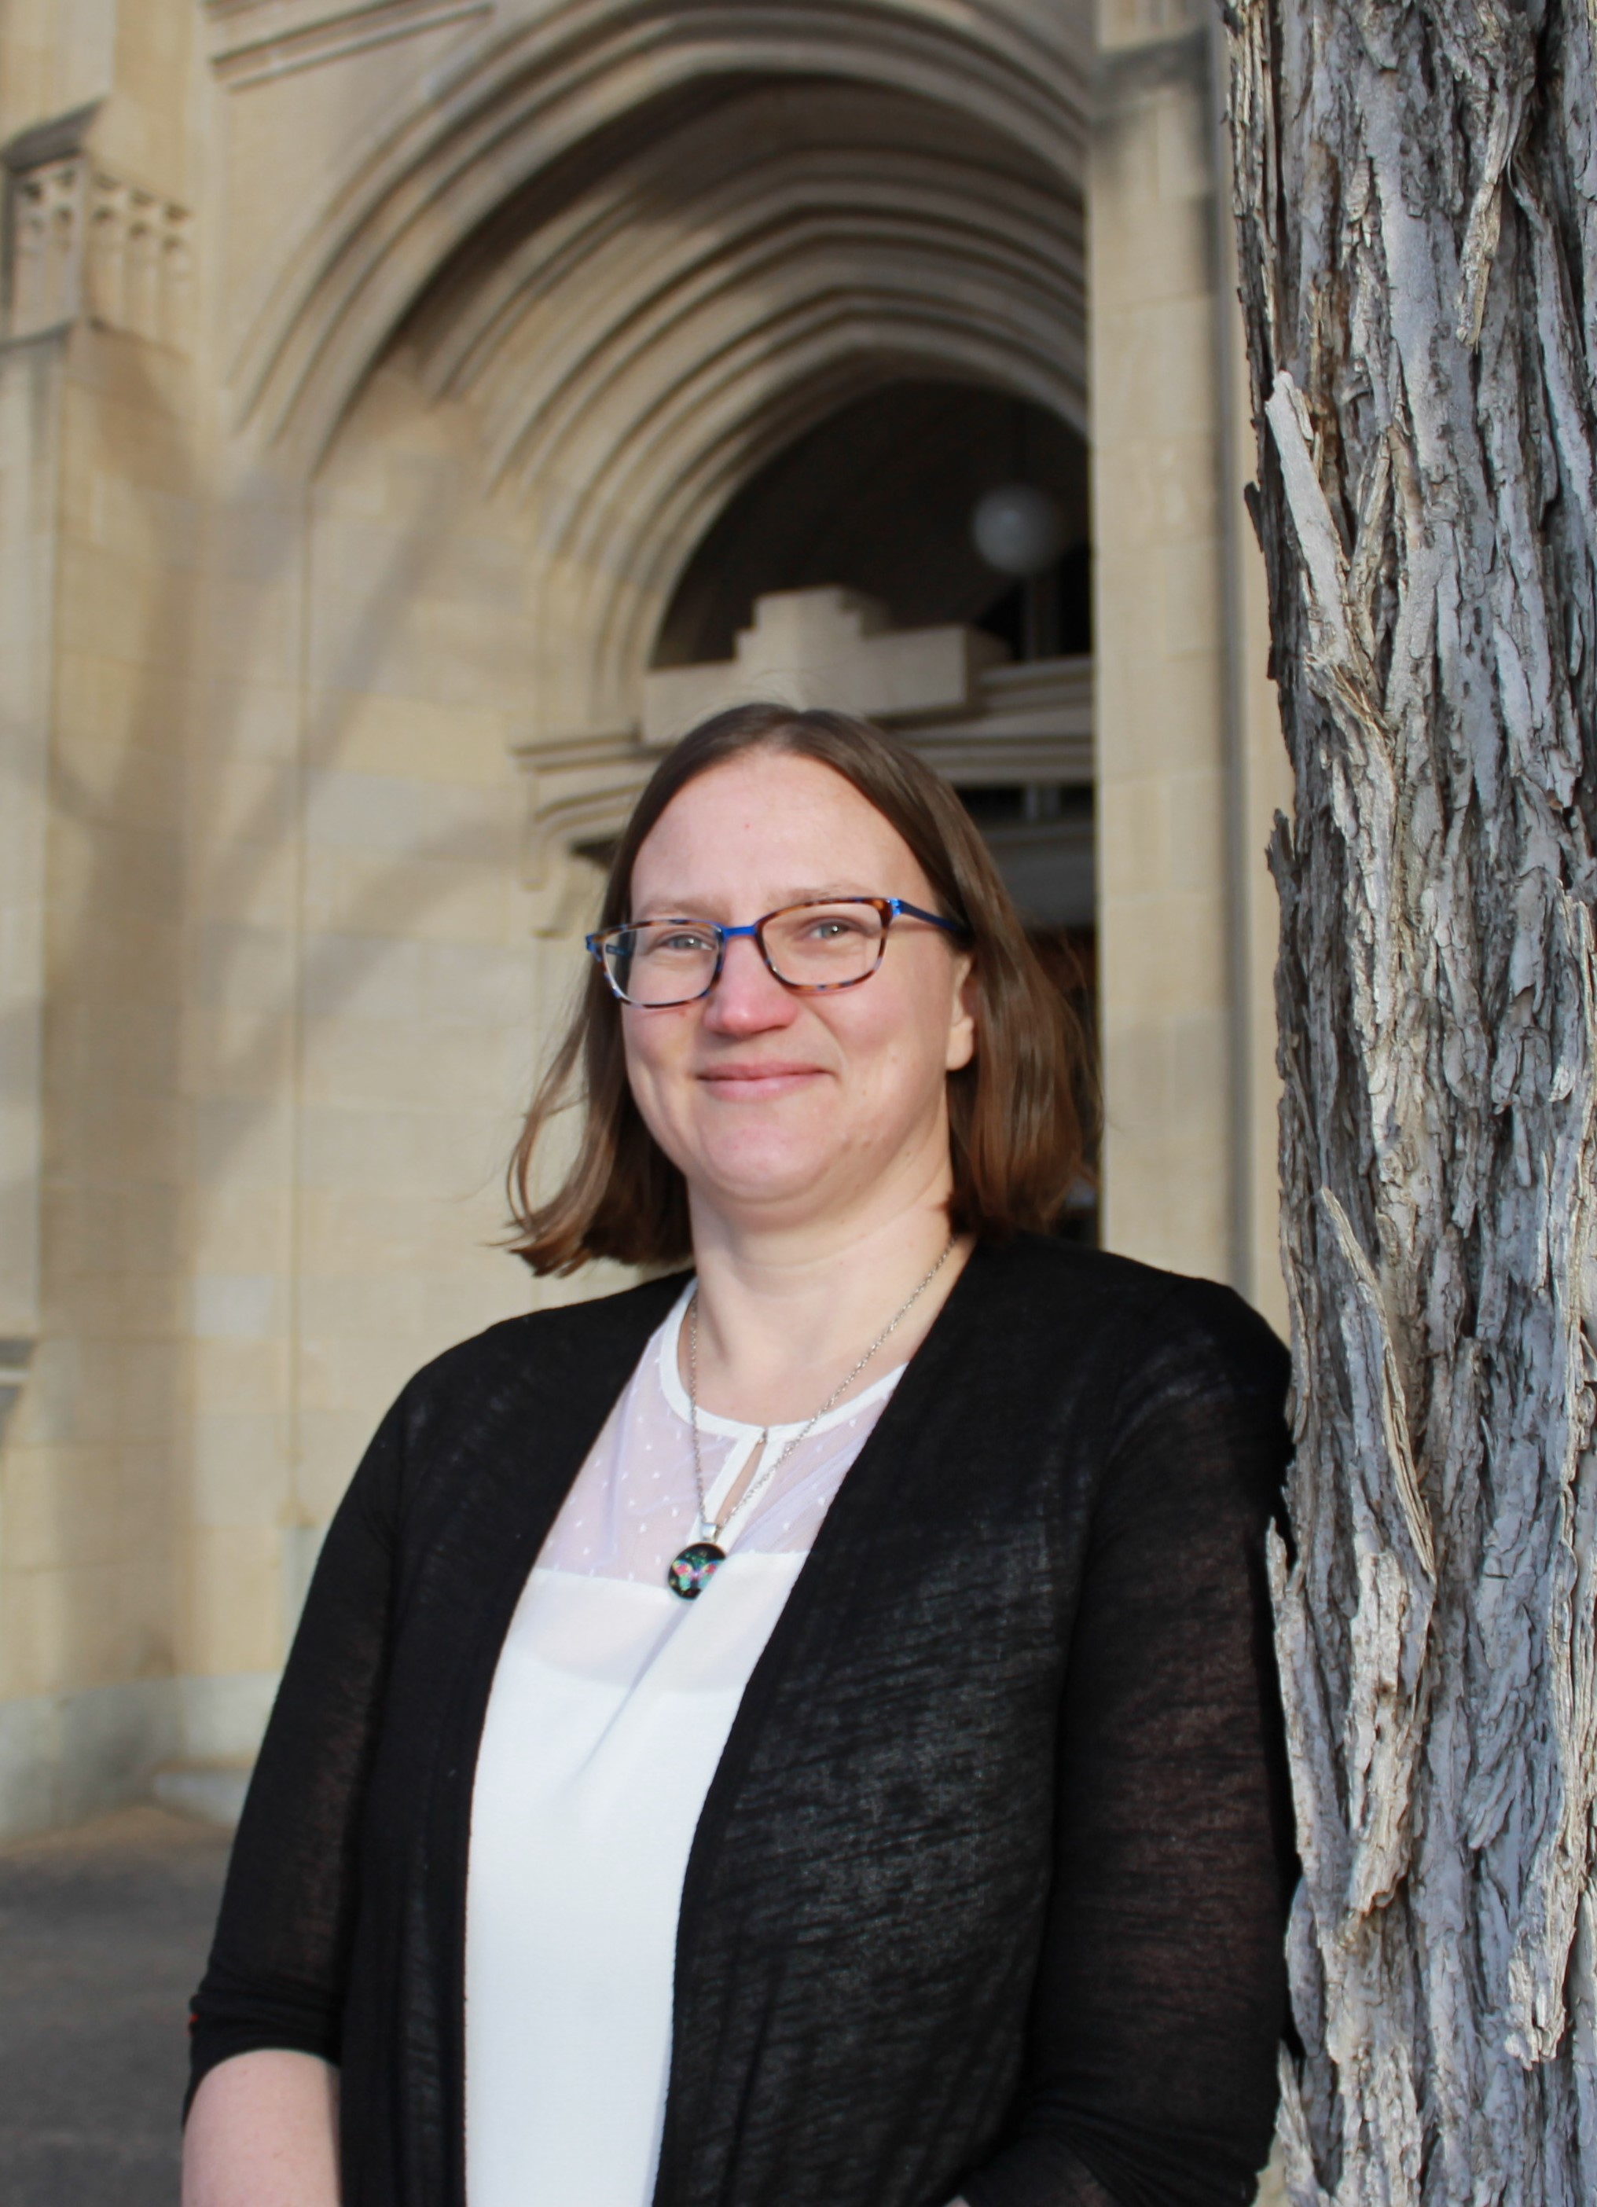
Panelists
Dr. Lori Bradford is the Canada Research Chair in Incorporating Social and Cultural Sciences into Engineering Design, and an Associate Professor in the Graham School of Professional Development. She is the Editor of Engaged Scholar Journal, and co-lead of the USask’s Communities and Sustainability Signature Area. Dr. Bradford specializes in evaluating inter- and transdisciplinary approaches to science collaborations using social network analysis, and in engaged scholarship on water and infrastructure security issues with Indigenous communities. She facilitates partnerships with environmental scientists, hydrologists, civil and environmental engineers, data scientists, and fine arts and humanists on translating their combined research efforts into meaningful forms for communities.

Slide 13
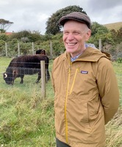
Panelists
Dr. David J. Parkinson is an Emeritus Professor of English at the University of Saskatchewan and has been fascinated by literature's transformative reflection of social change. His research centres on literary innovation in seventeenth-century Scotland and has resulted in editions of the works of three Scottish poets of the period, an edited collection of essays, and numerous articles. He recently completed an edition of Henry Adamson's The Muses Threnodie (1638) for the Scottish Text Society.

Slide 14
We look forward to working with you
Please contact us at:
international.office@usask.ca

