Slide 1
SSHRC Workshop: Library Supports for Researchers
Catherine Boden, MLIS, PhD
Assistant Dean, Research Support Services, University Library
May 1, 2023

Slide 2
Overview
Services
Resources
Workshops & Events
Questions
https://library.usask.ca

Slide 3
Areas of Support
Knowledge Syntheses/Evidence Syntheses
Data, Statistics & GIS
Research Data Management
Publishing & Copyright
HARVEST Institutional Repository
Digital Scholarship / Humanities

Slide 4
Knowledge Syntheses / Evidence Syntheses
Training, consultation and/or collaboration on literature searches for synthesis reviews (e.g., systematic reviews; scoping reviews; realist reviews; rapid reviews, and/or evidence syntheses)
RESOURCES:
Your liaison librarian.
Synthesis Review Toolkit (health sciences focused but still useful for many disciplines)
Preparing for grant applications – if you are applying for a grant to conduct a knowledge/evidence synthesis as part, or all, of the research plan, consider consulting your liaison librarian as early as possible if you would like assistance or collaboration.

Slide 5
Research Data Management
The University Library is working in partnership with service centres across campus (e.g., ICT, OVPR) to develop comprehensive RDM supports for researchers.
RESOURCES:
RDM research guide
WORKSHOPS:
Live workshops are offered in Fall and Winter terms.
Workshop recordings.

Slide 6
Data, Statistics and GIS
Support for finding data (e.g., aggregate, microdata, time series, textual). The University Library works in partnership with Research Computing and CHASR to provide GIS data, services, software, training to the USask community.
RESOURCES:
Your liaison librarian.
Data research guide
GIS research guide
CHASR
Saskatchewan Research Data Centre (SKY-RDC) is “a research data platform that provides researchers … access to Statistics Canada microdata masterfiles of Canadian censuses, cross-sectional and longitudinal population and household surveys, administrative data holdings and linked data.”
Notes:
he Saskatchewan Research Data Centre (SKY-RDC) is a research data platform that is part of a nation-wide network of research data centres (RDCs) - the Canadian Research Data Centres Network (CRDCN). We are a joint venture of the University of Saskatchewan and Statistics Canada, providing secure access to detailed microdata from Statistics Canada's surveys and censuses. Increasingly, administrative datasets from the federal and provincial governments are also becoming available through RDCs.

Slide 7
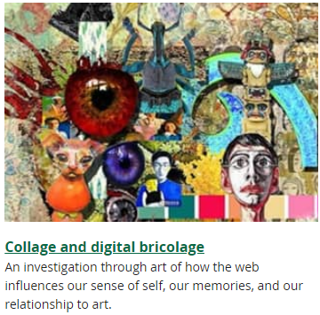
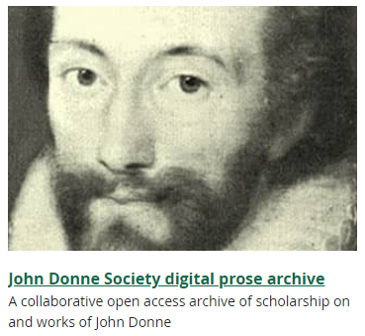
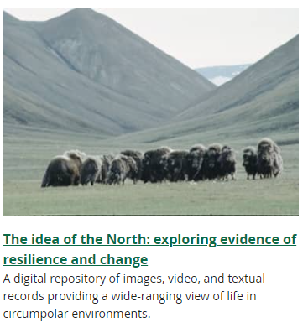
Digital Research Centre
The Digital Research Centre (DRC) provides digital scholarship support and collaborative spaces. Services include digital asset management, support for grant applications, and exhibits and digitization.
RESOURCES:
DRC website.

Slide 8
Publishing
Consultations and training on topics related to publishing, such as affordable ways to adhere Tri-Agency Open Access Policy on Publications, identifying reputable journals, author rights, and navigating publisher open access policies and copyright.
RESOURCES:
Your liaison librarian.
Open Access guide
Predatory Publisher guide
Author Rights guide
WORKSHOPS:
Live workshops are offered in Fall and Winter terms.
Workshop recordings.

Slide 9
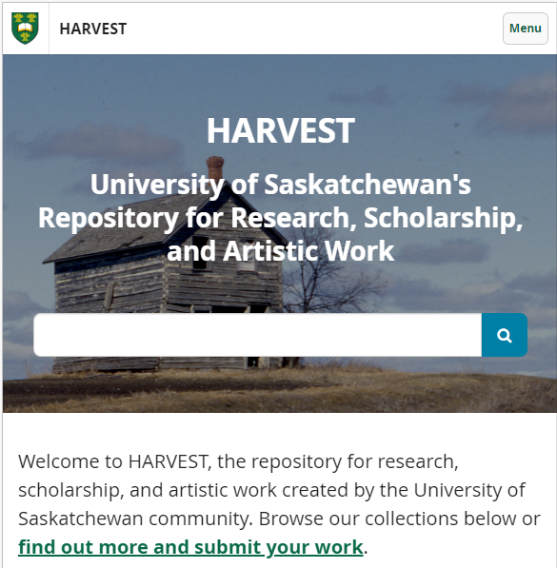
HARVEST
“the repository for research, scholarship, and artistic work created by the University of Saskatchewan community”
RESOURCES:
HARVEST website
Contact: HARVEST@library.usask.ca
WORKSHOPS:
Live workshops are offered in Fall and Winter terms.
Workshop recordings.

Slide 10
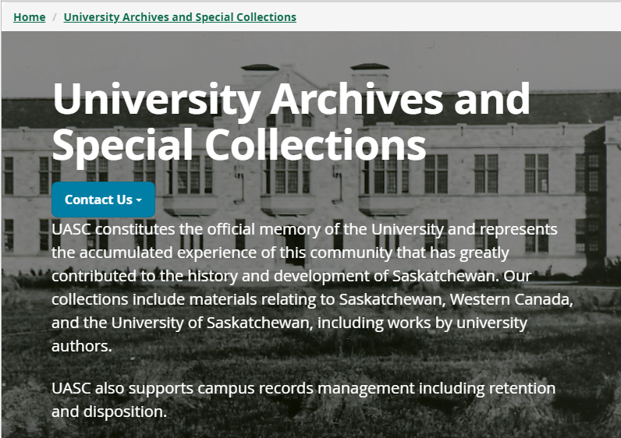
University Archives and Special Collections (UASC)
Canadian Hub for Applied and Social Science Research (CHASR)

Slide 11
https//library.usask.ca

Slide 12
Your University Library: We’re Here to Help
LIBRARY.USASK.CA

