Slide 1
Citation Justice
Maha Kumaran and Sheila Laroque
Research, Scholarly, and Artistic Work (RSAW) Presentation
December 13, 2024

Slide 2
AGENDA
Conception of this idea
What is Citation Justice (and what it isn’t?)
7Rs of Indigenous Research
EDI concepts
Neutrality
Epistemic injustice
Willful ignorance
Social justice
wâhkôhtowin
iPortal – a potential case study
Why and What?
Existing Tools and other Resources

Slide 3
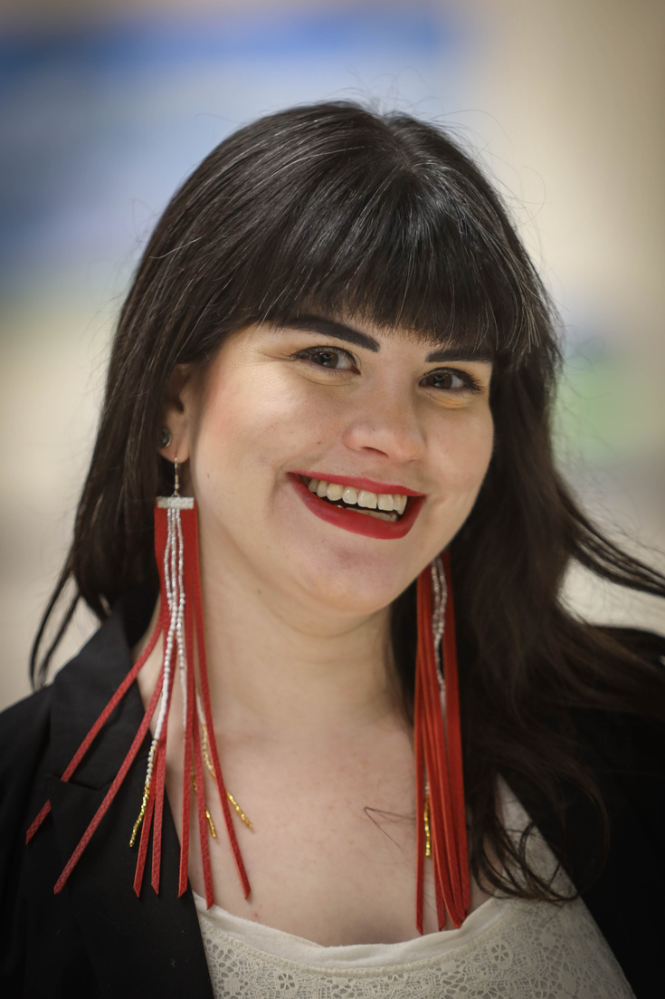
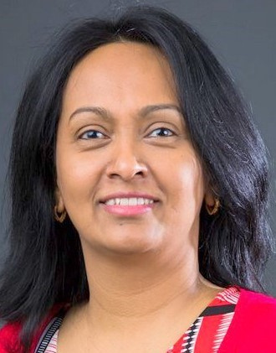
Who We Are
Sheila Laroque
Maha Kumaran

Slide 4
Inspiration
Kwon, Diana. (2022). The Rise of Citational Justice. Nature, 603(7902). https://doi.org/10.1038/d41586-022-00793-1
Help us engage in and advance citation justice for alumni and graduates of color. (2020, July 21). School of Education. https://www.colorado.edu/education/2020/07/21/help-us-engage-and-advance-citation-justice-alumni-and-graduates-color

Slide 5
What Citation Justice Is (and isn't)
Multilogicality Lens
“ a break from the class elitist, white-centered, colonial patriarchal histories” (and practices) Kincheloe & Steinberg, 2008
Equity
Breaking Barriers
Intentionality in practice and styles; amplifying the work of IBPOC scholars and researchers
Matthew Effect​
Matilda Effect
Citation Doping

Slide 6
7 R's of Indigenous Research
RECOGNITION / RIGHTS / REDRESS
RESPECT
RELATIONSHIPS / RECONCILIATION
RELEVANCE
RECIPROCITY
RESPONSIBILITY / RESPONSIVENESS
REPRESENTATION

Slide 12
Amplifying
Why and What
05
Amplify the profiles of marginalized researchers
Stopping Harm
04
Stop harming consequences (Buchanan et al., 2021)
Acknowledging
03
Especially the historically undervalued, marginalized, and underrepresent
Decolonizing
02
Decolonizing and (Re)conciling
Eurocentric
01
Citing is a Eurocentric Practice

Slide 13
Tools That Could Help
1
Connected Papers
3
Visible Minority Librarians of Canada Network
2
LitMaps
5
MacLeod, L. (2021). More Than Personal Communication: Templates For Citing Indigenous Elders and Knowledge Keepers. KULA: Knowledge Creation, Dissemination, and Preservation Studies , 5(1). https://doi.org/10.18357/kula.135
Younging, G. (2018). Elements of Indigenous style: A guide for writing by and about Indigenous peoples. Brush Education.
4

Slide 14
Contact Information
Maha Kumaran - Maha.kumaran@usask.ca
Sheila Laroque -
sheila.laroque@usask.ca

Slide 15
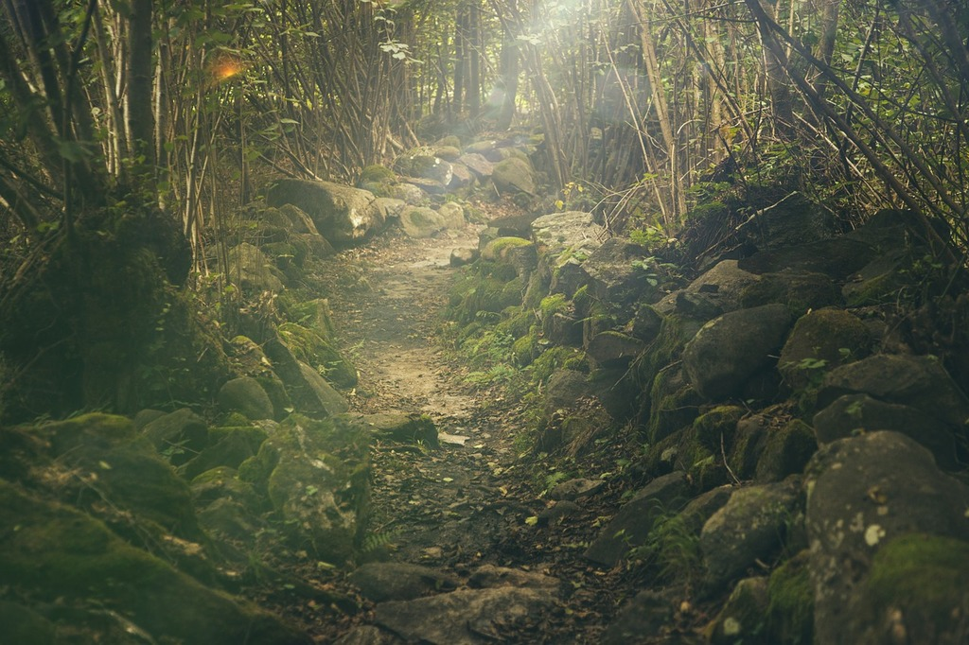
Questions ?
https://picryl.com/media/forest-path-mystical-nature-landscapes-296d9a

Slide 16
References
Anderson, K. (2000). A recognition of being: reconstructing native womanhood. Sumach Press. https://primo-pmtna02.hosted.exlibrisgroup.com/permalink/f/13mcj8r/USaskIII.b29192171
Bertolero et al, (2020). Racial and ethnic imbalance in neuroscience reference lists and intersections with gender. https://doi.org/10.1101/2020.10.12.336230
Buchanan, et al., (2021). Upending racism in psychological science: Strategies to change how science is conducted, reported, reviewed & disseminated. https://doi.org/10.1037/amp0000905
Campbell, K.M., & Wellman, S. (Eds.). (2023). Justice, Indigenous Peoples, and Canada: A History of Courage and Resilience (1st ed.). Routledge. https://doi.org/10.4324/9780429020858 (7Rs)
CAUT Bulletin (February 2019). The Matilda effect. https://www.caut.ca/bulletin/2019/02/matilda-effect
Collier, A. (2020). Inclusive design and design justice. Strategies to shape our classes and communities. Educause, 4, p. 10 – 23.
Gilley, B. (2023). How junk citations have discredited the academy. https://www.mindingthecampus.org/2023/03/30/how-junk-citations-have-discredited-the-academy-part-4/
Grande, S. (2018). Refusing the university. In E. Tuck., & K.W. Yang (Eds.), Toward what justice: Describing diverse dreams of justice in education (pp.47-65). Taylor & Francis.
Kincheloe, J.L. & Steinberg, S.R. (2014). Handbook of critical and Indigenous methodologies. Sage.

Slide 17
References
Loyer, J. (2018). Indigenous information literacy: nêhiyaw kinship enabling self-care in research. Library Juice Press. https://core.ac.uk/download/pdf/153541453.pdf
MacLeod, L. (2021). More than personal communication: Templates for citing Indigenous elders and knowledge keepers. KULA: Knowledge Creation, Dissemination, and Preservation Studies , 5(1). https://doi.org/10.18357/kula.135
Merton, R.K. (1988). The Matthew effect in science, II: Cumulative advantage and symbolism of intellectual property.
National Oceanic and Atmospheric Administration (2021). The 7 Rs of integrating tribal and Indigenous partnerships into aquaculture literacy. https://www.noaa.gov/office-education/stories/7-r-s-of-integrating-tribal-and-indigenous-partnerships-into-aquaculture-literacy
Noble, S. U. (2018). Algorithms of oppression. New York University Press. https://primo-pmtna02.hosted.exlibrisgroup.com/permalink/f/3k8mfj/USaskIII.b44319204
Rossiter, M.W. (1993). The Matthew Matilda effect in science. Social Studies of Science, 23(2), p. 325-341.
Savonick, D., & Davidson, C. (2017). Gender bias in academe: An annotated bibliography of important recent studies. https://academicworks.cuny.edu/qc_pubs/163/
Rsosie, Teich, E.G. et al (2021). Citation inequity and gendered citation practices in contemporary physics. https://doi.org/10.1038/s41567-022-01770-1
Tsosie, R.L., Grant, A.D., Harrington, J., Wu, K., Thomas, A., Chase, S., Barnett, D., Hill, S.B., Belcourt, A., Brown, B., & Sweetgrass-She Kills, R.P. The six Rs of Indigenous research. https://tribalcollegejournal.org/the-six-rs-of-indigenous-research/
University Plan (2025). University of Saskatchewan. https://plan.usask.ca/documents/University-Plan-2025.pdf
Wang, et al., (2021). Gendered citation practices in the field of communication. https://doi.org/10.1080/23808985.2021.1960180
Younging, G. (2018). Elements of Indigenous style: A guide for writing by and about Indigenous peoples. Brush Education. https://primo-pmtna02.hosted.exlibrisgroup.com/permalink/f/3k8mfj/USaskIII.b48867299

