Slide 1
A very brief intro to librarians as researchers…

Slide 2
Librarians are often “practitioner-researchers”
Professional practice
Research

Slide 3
My own practitioner-researcher story

Slide 4
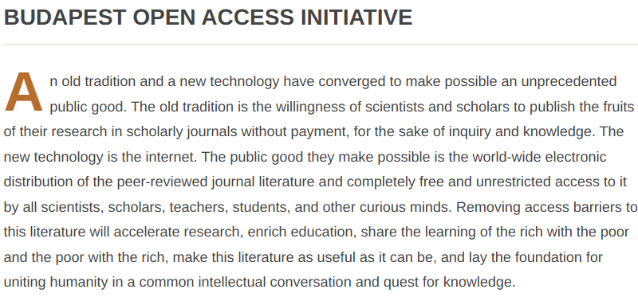
https://www.budapestopenaccessinitiative.org/read/ Feb. 2002

Slide 5
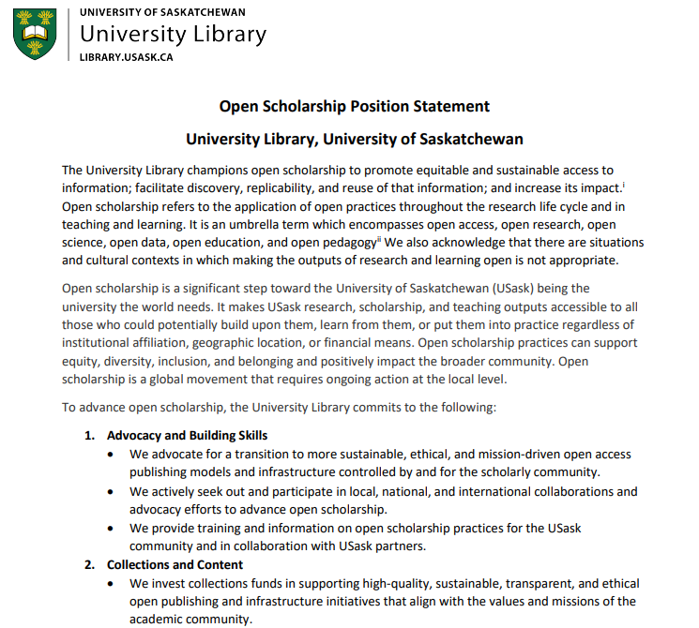
Professional practice: Open Scholarship Librarian
Supporting researchers (services, consultations, education/training)
Advocacy
https://library.usask.ca/documents/open-scholarship-position.pdf

Slide 6
Research program:
All aspects of supporting a transition to a more equitable, ethical, and sustainable system of scholarly communication.

Slide 7
Barriers to Flipping LIS Journals to Diamond Open Access: A Two-Part Study
Rachel Borchardt, American University
DeDe Dawson, University of Saskatchewan
Teresa Schultz, University of Nevada, Reno
Notes:
[diamond clip art CC0 https://www.clipsafari.com/clips/o168907-shiny-diamond]

Slide 8
Values of Academic Libraries
ACRL
“…recommends as standard practice that academic librarians publish in open access venues.”
“…recommends as standard practice that publishers of library and information sciences scholarship explore and implement open practices.”
https://www.ala.org/acrl/standards/openaccess

Slide 9
The OA Model Matters
Journal models based on charging authors fees, whether hybrid or fully OA, are inequitable for authors.

Slide 10
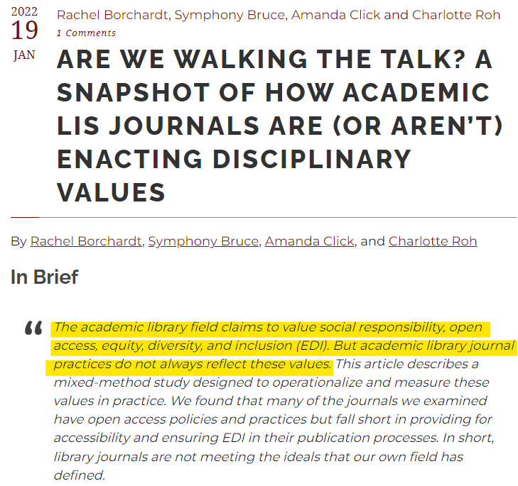
>>>
42% of LIS journals still use an inequitable hybrid OA model
https://www.inthelibrarywiththeleadpipe.org/2022/walking-the-talk/

Slide 11
Two Part Research Project: The Purpose
What (perceived) barriers prevent these LIS journals from transitioning to a diamond OA model?

Slide 12
Two Part Research Project: The Goal
The ultimate goal of this research is to provide a feasible route to transitioning as many LIS journals as possible to more open, equitable, and sustainable models.

Slide 13
Part 1: Survey of LIS Editors (Unflipped) - 20 journals Part 2: Interviews with LIS Editors (Unflipped & Flipped) - 15 journals

Slide 14
Summary of Results: The Barriers
Lack of…
Finances (& lack of knowledge of finances)
Knowledge of OA & various OA funding models
Power & agency
Other challenges…
Complexity & bureaucracy
Labour issues

Slide 15
Next steps...
Short term:
Targeting likely journals (mission-driven ones)
Encourage author/reviewer/editorial board action
Support for editors (e.g., CoP)

Slide 16
Next steps...
Long term:
Aligning RPT guidelines with open values & rewarding journal labour
Implementing shared-support model (e.g., OLH)

Slide 17
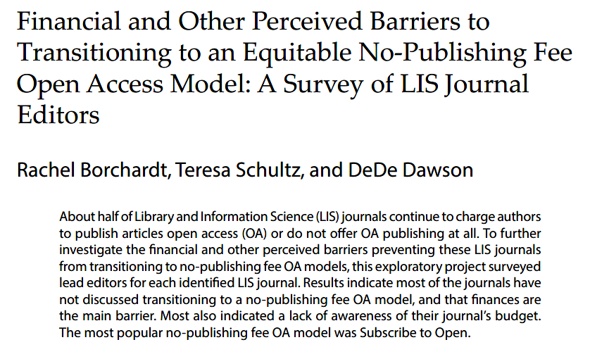
Publications of results:
Part 1 (Survey):
Part 2 (Interviews):
In press
https://doi.org/10.5860/crl.85.1.96 January, 2024

Slide 18
The End

