Slide 1




Tri Agency CV Workshop
December 9, 2025; 1:30 – 3:00 pm
Presented by: Tri Agency Team at Office of Vice President Research

Slide 2




AGENDA
1:30 – 1:40 pm: Welcome and Opening Remarks
1:40 – 2:00 pm: Introductory Notes
  New initiative: “Building your path to Tri Agency Success: Grant Development Series for USask Faculty”
  Session #1 on TCV
2:00 - 2:20 pm: Presentations by federal team at Tri Agency
  Robin Craig, Associate Vice President, Research Grants and Scholarships Directorate, NSERC
  Sera Paktunc, Project Manager, Operations Support, Canadian Institutes of Health Research
  Annik Poirier, Deputy Director, Operations Support, Canadian Institutes of Health Research
2:20 – 2:40 pm: Q&A session
2:40 – 3:00 pm: Closing Remarks
  Overview of resources and supports available
  Road Ahead: over the course of several sessions faculty (and staff) will be supported through tools, strategies and resources that enable faculty to craft a captivating evidence-based narrative CV
Tri Agency CV Workshop

Slide 3

Building your path to Tri Agency Success: Grant Development Series for USask Faculty
Key Highlights
Cover major elements of grant development: idea generation, proposal writing, selecting appropriate peer review committee/evaluation group, building strong and inclusive research teams, budgeting, impact, etc.
Offer platform for our researchers to explore opportunities for interdisciplinary research and build a collaborative culture at USask
USask Tri Agency team will facilitate and provide support to make those collaborative connections across disciplines and campus
Equip faculty with knowledge of resources and supports available and enable them to better understand agency and institutional compliance requirements & post‑award considerations
Insights into grant preparation and writing process, emphasizing distinct mandates of SSHRC, NSERC and CIHR
Tri Agency CV Workshop
Notes:
From Slide 3
“Building your path to Tri Agency Success: Grant Development Series for USask Faculty”
Brand-new initiative launched by the Tri Agency team at the Office of Vice President Research (OVPR)
Focuses on uplifting performance and promoting Tri Agency excellence at USask
Designed to help faculty effectively navigate the process of seeking Tri Agency funding
Objective is to support faculty with tools and resources that will help them craft competitive applications and build their path towards success at Tri Agency grants.
From Slide 5
The first session as part of this Grant Development Series is on Tri Agency CV (TCV)
Over the course of several sessions, faculty will be supported through tools, strategies and resources that enable faculty to craft a captivating evidence-based narrative CV
The goal of TCV sessions will be to help facilitate a smooth transition into the new narrative style CV
Gain a clear understanding of the format, structure, and Tri Agency requirement for their new narrative style CV format
For this session we have Federal representatives from Tri Agency presenting at the workshop and offering valuable insights and guidance into objectives and expectations of the TCV

Slide 4

  Presentation by the Federal Team
  Robin Craig, Associate Vice President, Research Grants and Scholarships Directorate, NSERC
  Sera Paktunc, Project Manager and
  Annik Poirier, Deputy Director
  Operations Support, Canadian Institutes of Health Research
Tri Agency CV Workshop

Slide 5

Moderated Q&A
Tri Agency CV Workshop

Slide 6

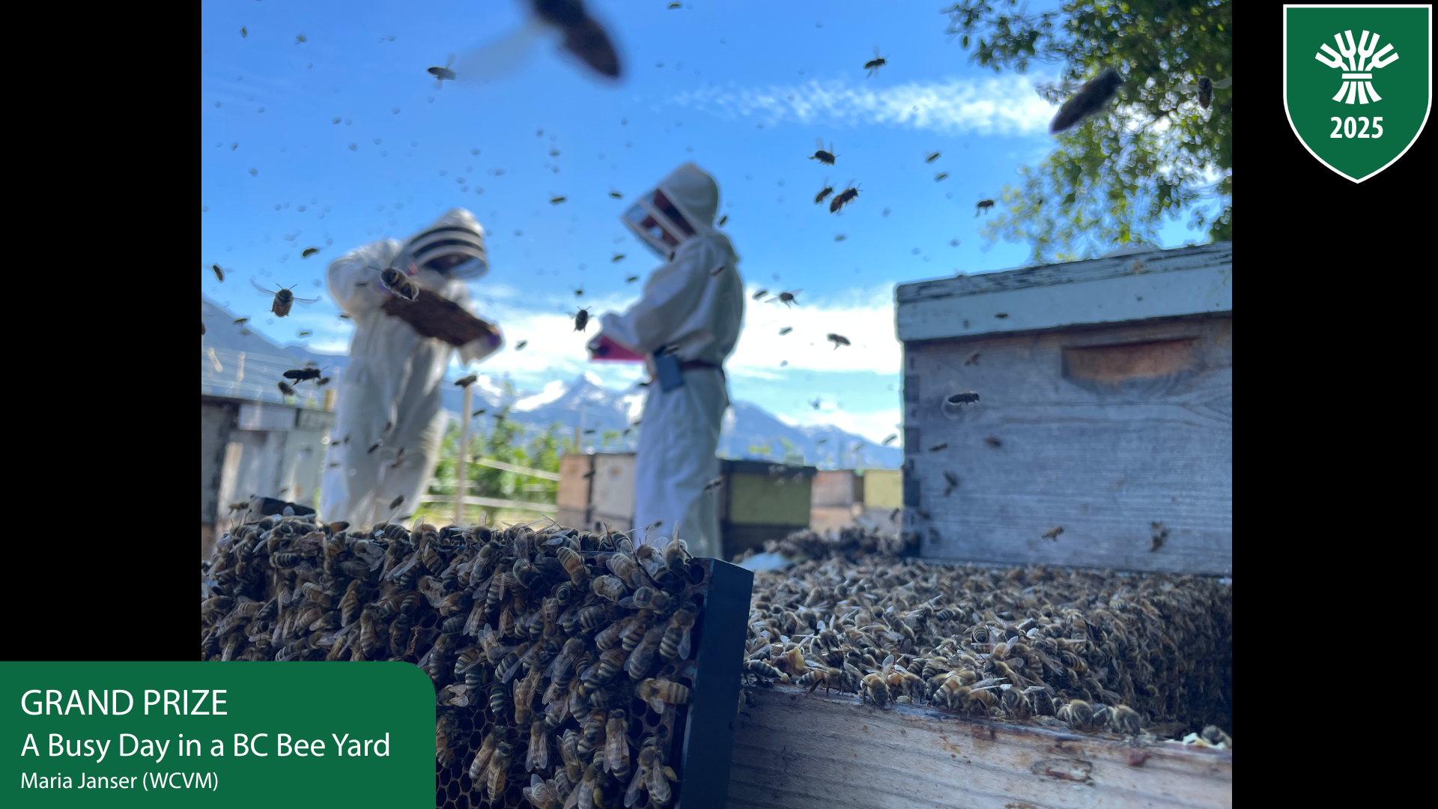
Resources and Supports
Tri Agency Resources
Canadian Resources
International Resources
PRESENTATION NAME

Slide 7
Resources and Supports – Tri Agency Resources
TRI AGENCY RESOURCES
  Start with Tri-agency CV template
  Familiarize yourself with TCV instructions and ensure you follow the correct instructions from the agency you are applying to
      Tri-Agency CV instructions for CIHR
      Tri-Agency CV instructions for SSHRC
      Tri-Agency CV instructions for NSERC Discovery Horizons (Pilot)
    Five pages for English and Six pages for French version
    No limit for any of the three sections are long as total page limit is not exceeded
PRESENTATION NAME

Slide 8
Resources and Supports – Tri Agency Resources contd..
  Guidance for writing a narrative CV
    Self-learning tool kit has been developed by Tri Agency to guide you through the writing process
    All the tips, tricks, guiding principles and content that go into different sections of the TCV have been summarized and integrated into a word document for easy access
      Narrative CV Writing Guide
  Review the FAQs for TCV: these may support you in using the new template effectively
    These Qs range from format requirements, to situation-based, to general inquiry about TCV
      In the Personal statement section, what does "Lived and/or living experience(s)" mean?
      What can I do if my opportunities for training students have been limited because my institution does not have a graduate degree program?
      Who can I contact if I have questions about the tri-agency CV?
PRESENTATION NAME

Slide 9
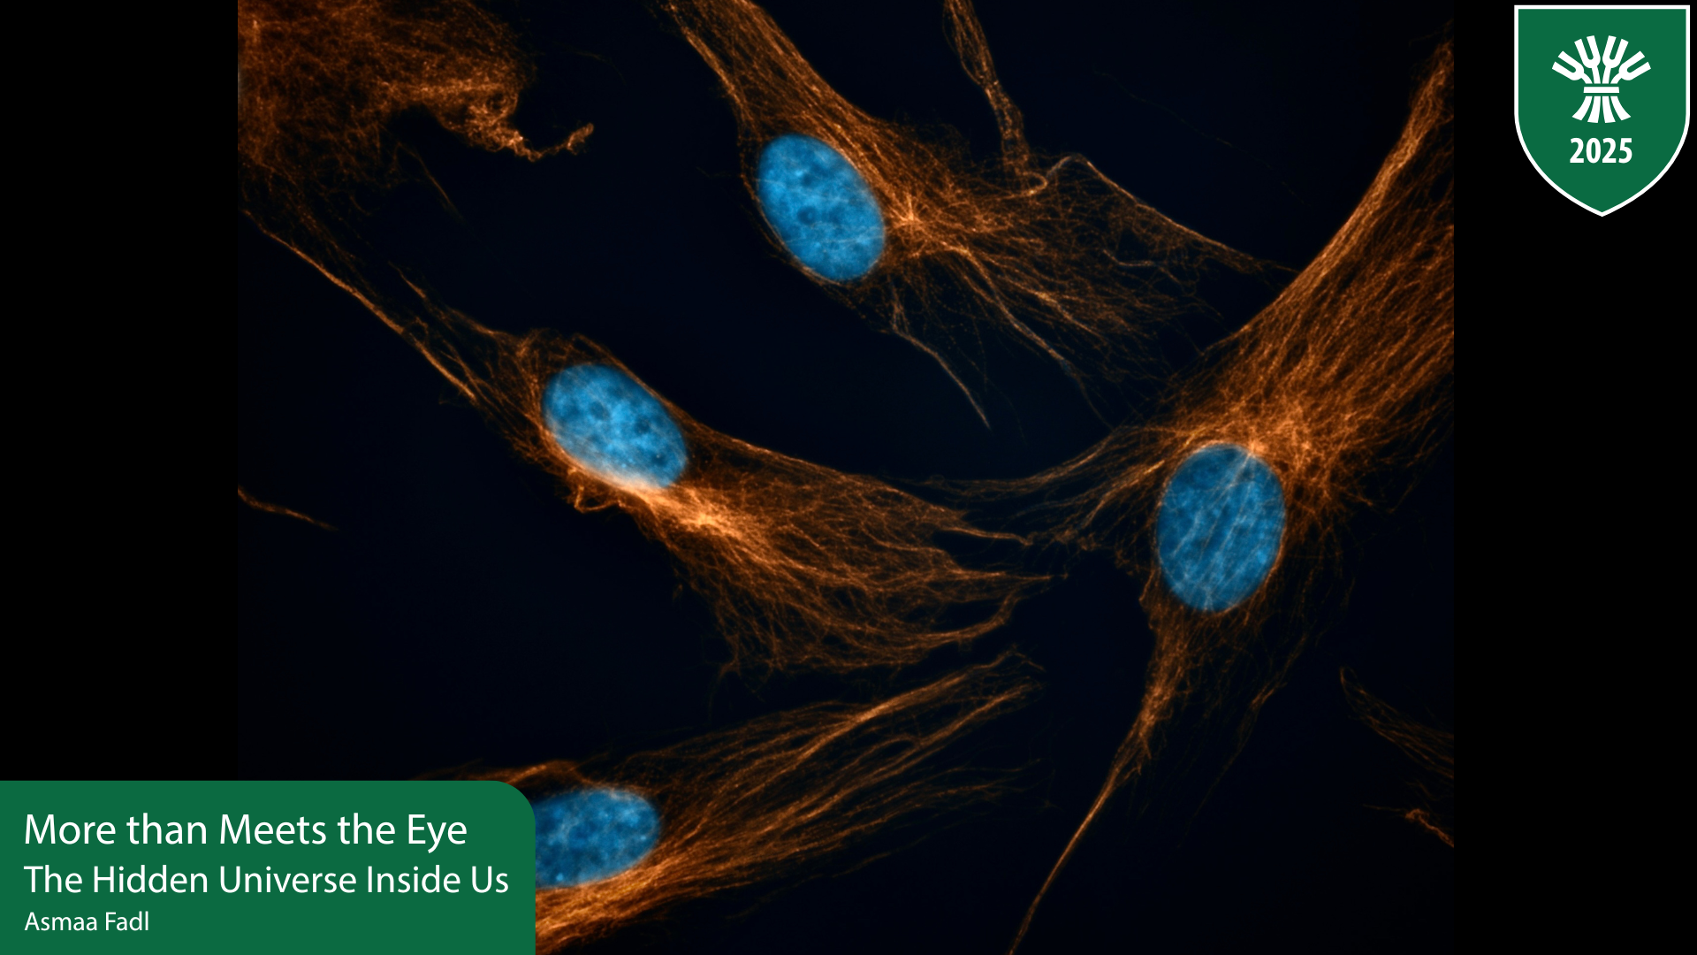
Resources and Supports – Canadian Resources
  CANADIAN RESOURCES
Readings
Videos
Templates and Examples
PRESENTATION NAME

Slide 10
Resources and Supports – Canadian Resources
  1. Suggested Reading
    Concordia University: Crafting a Compelling Narrative CV
    University of Calgary
      Guide to Writing A 'Most Significant Contributions' Statement
      Webinar on Telling Your Research Story: Drafting Your TCV (Slides)
    University of Alberta: Baseline Competencies of Writing a Compelling Narrative CV (Slides)
    Simon Fraser University Library: Narrative CVs: prioritizing impact and influence
    University of Winnipeg: Guidance for Narrative CVs for Canada Research Chair Applications
PRESENTATION NAME

Slide 11
Resources and Supports – Canadian Resources
  Suggested Reading contd..
    University Affairs:
      How to write a narrative CV
      Writing a successful narrative CV
    Research Impact Canada: Navigating Narrative CVs in Canada: Preparing for the Transition (Slides)
  2. Videos
  University of Calgary: Webinar on Drafting your TCV
  Research Impact Canada: Navigating Narrative CVs in Canada: Preparing for the Transition :
PRESENTATION NAME

Slide 12
Resources and Supports – Canadian Resources contd..
  3. Templates and Examples
  University of Winnipeg: Narrative CV Template
  University Affairs: ‘Ask Dr. Editor’ by Letitia Henville has provided some free to use narrative CV templates that may help you draft your own TCV
    CIHR
      Narrative CV template for ECR
      Narrative CV template for Established Researcher
    NSERC
      Narrative CV template for ECR
      Narrative CV template for Established Researcher
    SSHRC
      Narrative CV template for ECR
      Narrative CV template for Established Researcher
PRESENTATION NAME

Slide 13
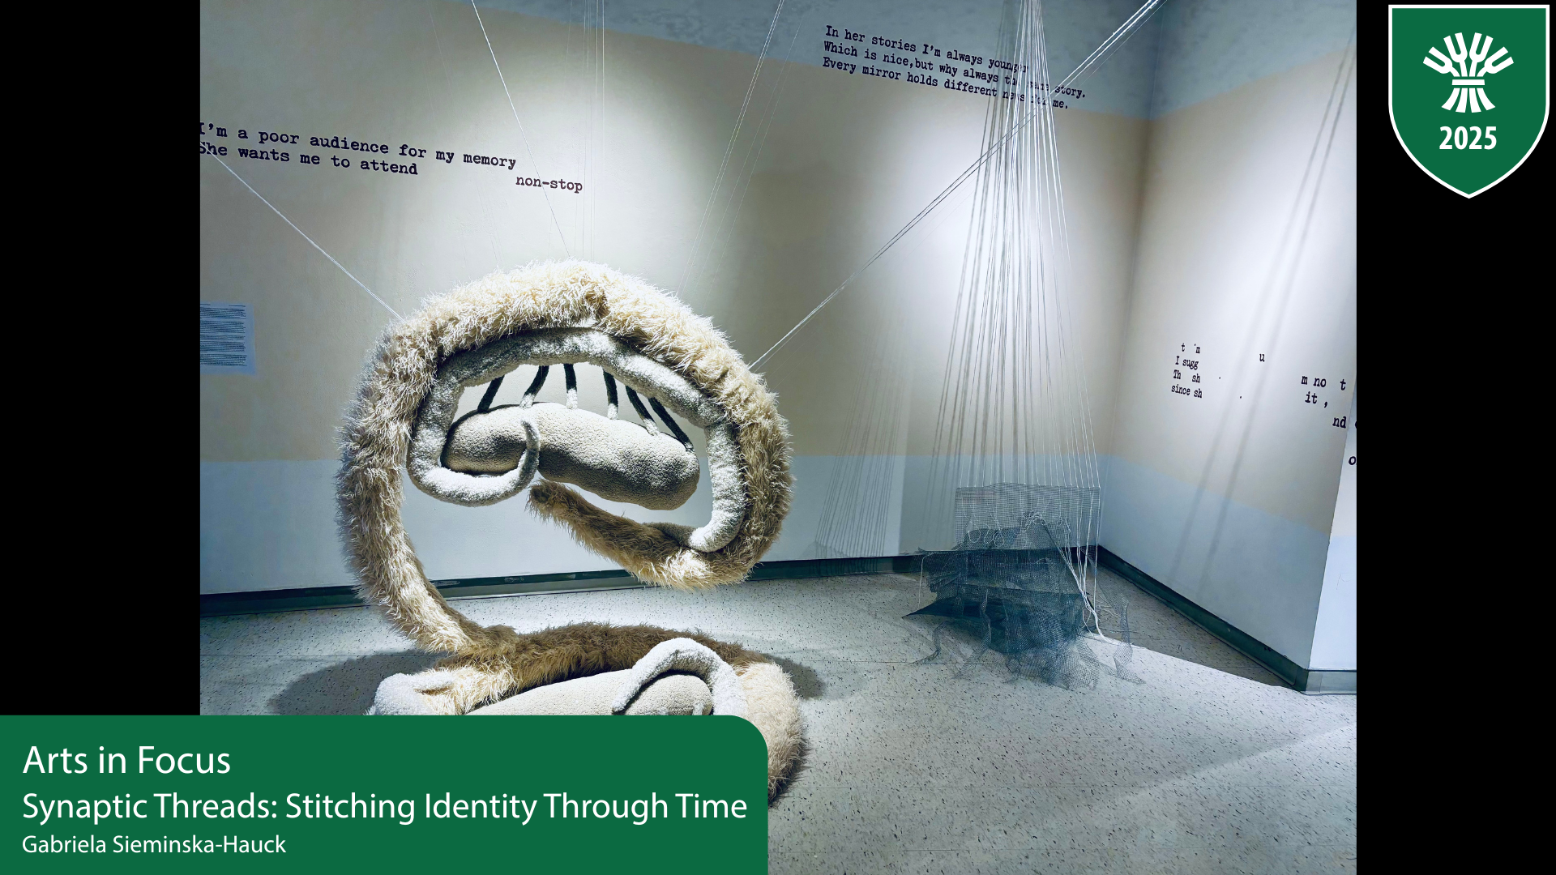
Resources and Supports – International Resources
  INTERNATIONAL RESOURCES
Readings
Videos
Podcasts
Examples of Narrative CV
PRESENTATION NAME

Slide 14
Resources and Supports – International Resources cont’d
  1. Suggested Readings
    Science Foundation Ireland: Guidance on their Narrative CVs
    University Of Leeds:
      Creating your Resume for Researchers or Narrative CV
      A guide to reviewing narrative CVs
      Sharing Your Achievements with “CAR” Stories
          This article will help you with writing about your achievements. It highlights how using the Challenge, Action and Result approach will help you recognize your invaluable contributions
    Imperial College London: Narrative CVs | Research
PRESENTATION NAME

Slide 15
Resources and Supports – International Resources cont’d
  1. Suggested Readings contd..
    Luxembourg National Research Fund – Narrative CV Workshop (Slides)
    University of Dundee: Narrative CV Workbook
      This workbook guides you through reflective questions to help you with a narrative CV
    University of Sheffield: Narrative CVs | Research | The University of Sheffield
          Provides Information, guidance, and examples of best practice to support both researchers prepare their narrative CVs and reviewers evaluating them
PRESENTATION NAME

Slide 16
Resources and Supports – International Resources cont’d
3. Videos
    University Of Dundee : Narrative CV's - Tips for getting started
    University of Glasglow: Narrative CV webinar August 2021
    Oxford University webinar: How to write a narrative CV for funding applications
    Narrative CV format Across UK funders
PRESENTATION NAME

Slide 17
Resources and Supports – International Resources cont’d
4. Podcasts
  Careers in your Ears: Series 10: Ep6 Narrative CVs Demystified (May 2024) The episode features Kate Murray and Becky Ioppolo, members of the ARRC team, who discussed their study on the use of NCVs in academic hiring and what they’ve learnt through the process so far.
  How to Create a Narrative CV - Dementia Researcher - A podcast with four experts discussing how to write one
  University of Leeds Research Culture Uncovered Episode 2 Narrative CVs in Research Showcasing the Value of Every Contribution and Episode 3 Harnessing the Power of Collaboration: Writing persuasive, team-based Narrative CVs
5. Course on Writing Narrative CV
  Narrative CV: resources to help you write one | Rise 360
PRESENTATION NAME

Slide 18
Resources and Supports – International Resources cont’d
2. Narrative CV Examples
    University of Surrey: R4R-like-CV-annotated-for-guidance-purposes.pdf
    University of Sheffield
      For STEM Researchers: Examples of best practice in narrative CVs for STEM researchers
      For Arts, Humanities and Social Sciences Researchers: Examples of best practice in narrative CVs for Arts, Humanities and Social Sciences researchers
    Templates of Narrative CV used by international agencies
      Résumé for Researchers template tool
      Applicant-and-Co-Applicant-Narrative-CV-Template.docx
PRESENTATION NAME

Slide 19
Recap of Key Resources
Narrative CV Writing Guide: the document provides tips, tricks, guiding principles and description of sections of the TCV.
TCV Learning Tool
Narrative CV Examples
      CIHR
        Narrative CV template for ECR
        Narrative CV template for Established Researcher
      NSERC
        Narrative CV template for ECR
        Narrative CV template for Established Researcher
      SSHRC
        Narrative CV template for ECR
        Narrative CV template for Established Researcher
  For STEM Researchers: Examples of best practice in narrative CVs for STEM researchers
  For Arts, Humanities and Social Sciences Researchers: Examples of best practice in narrative CVs for Arts, Humanities and Social Sciences researchers
PRESENTATION NAME

Slide 20
USask Tri-Agency Team
USask Tri-Agency Leaders:
Dr. Darcy Marciniuk, CIHR
Dr. Julia Boughner, NSERC
Dr. Dawn Wallin, SSHRC
USask Tri-Agency Research Development Specialists:
Manisha Jalla, CIHR
Michaela Lynds, NSERC
Kristina Rissling Olson, SSHRC https://vpresearch.usask.ca/research-support/tri-agency.php
Tri Agency CV Workshop

Slide 21
Thank You!!!!
Tri Agency CV Workshop

