Slide 1
May 16, 2023 Workshop
NSERC Discovery Grants & RTI
Evaluation Groups:
1501 – Genes, Cells and Molecules 1502 – Biological Systems and Functions 1503 – Evolution and Ecology
1504 – Chemistry
1505 – Physics
1506 – Geosciences
1507 – Computer Science
1508 – Mathematics and Statistics
1509 – Civil, Industrial and Systems Engineering
1510 – Electrical and Computer Engineering 1511 – Materials and Chemical Engineering 1512 – Mechanical Engineering
SAP – Sub-atomic Physics
www.usask.ca

Slide 2
We acknowledge that we live and work on Treaty 6 Territory and the Homeland of the Métis. We pay our respect to the First Nations and Métis ancestors of this place and reaffirm our relationship with one another.
~ Please note: this workshop is being recorded.
Schedule of events
Welcome, Introductions, and Overview of the
Evaluation/Rating Process at NSERC
Research Facilitators & Specialists:
Tips on HQP, EDI, CCV, and Internal Review
NSERC DG Evaluation Group Members: Tips from adjudication Q&A
Session on RTI Grants: Research Facilitators and RTI Evaluation
Group Members; Q&A
1:00 – 1:10 PM
1:10 – 1:35 PM
1:35 – 2:00 PM
2:00 – 2:30 PM
2:30 – 3:00 PM
www.usask.ca

Slide 3
Research Facilitators and EG/RTI members presenting:
Ron Borowsky, (NSERC Lead) Professor, Psychology (Cognition and Neuroscience); A&Sc
EG 1502 – Biological Systems & Functions - Merit & Ratings
Research Facilitators:
Danielle Baron, Ag & Bio - HQP
Tera Ebach, WCVM - EDI
Heidi Smithson, Engineering - CCV
Manisha Jalla, OVPR - Internal Review
RTI Session:
Heidi Smithson, Engineering
Jaswant Singh, Professor, Veterinary Biomedical Science; WCVM,
EG 1502 – Biological Systems and Functions
Robert Scott, Professor, Chemistry; A&Sc,
EG 1504 – Chemistry
Raymond Spiteri, Computer Science; A&Sc,
EG 1508 (Group Chair) – Mathematics and Statistics
Ildiko Badea, Professor, Pharmacy and Nutrition
EG 1511– Materials and Chemical Engineering
Michel Gravel, Professor, Chemistry, A&Sc
RTI Evaluation Group: Chemistry
Suresh Tikoo, Professor, School of Public Health, VIDO
RTI Evaluation Group: Genes, Cells and Molecules
www.usask.ca

Slide 4
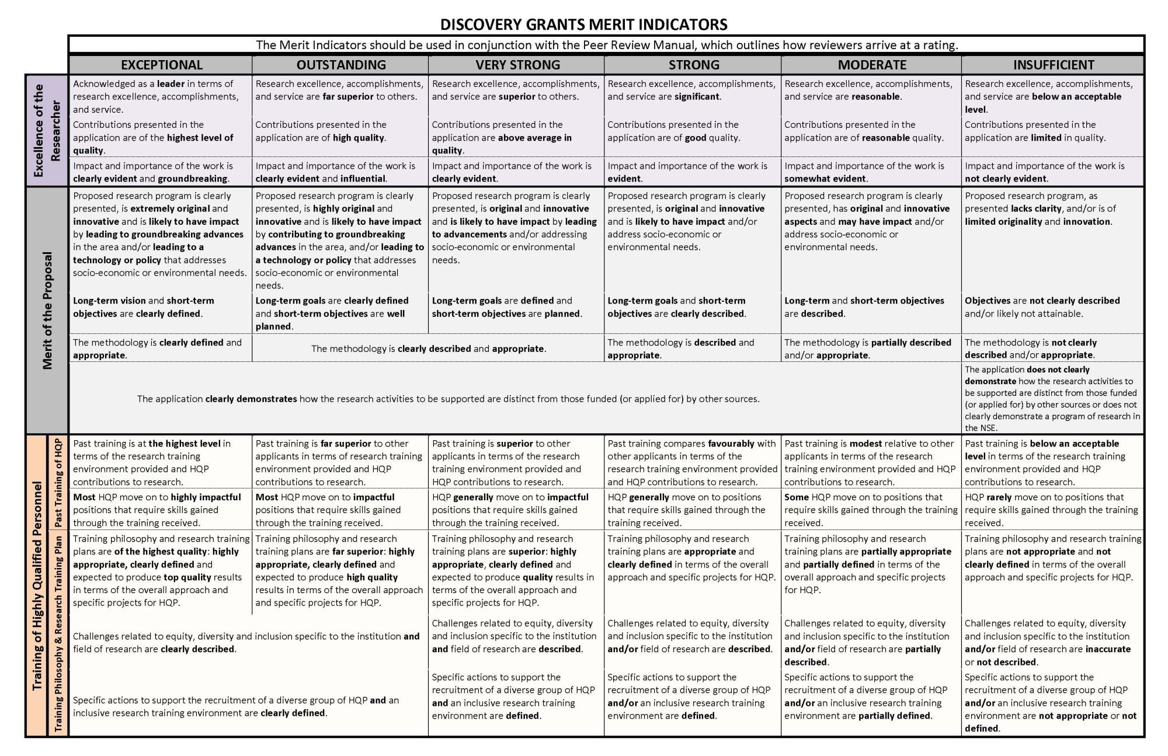
The Merit “Grid”
www.usask.ca

Slide 5
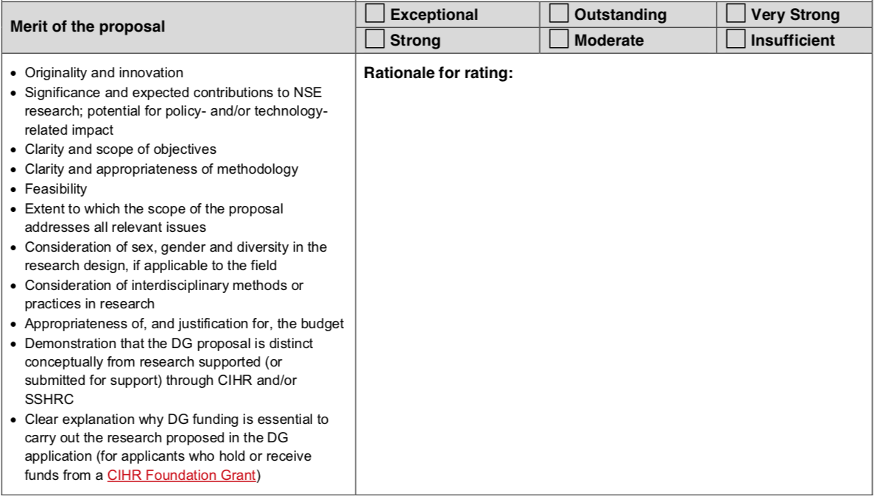
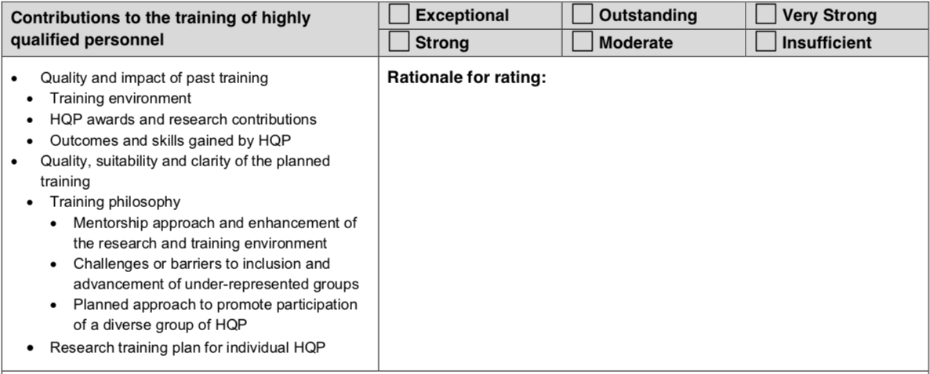
NSERC DG Rating Form – Ron Borowsky
Now “where”
￼
EDI of HQP! (see slides from our next 2 presenters)

Slide 6
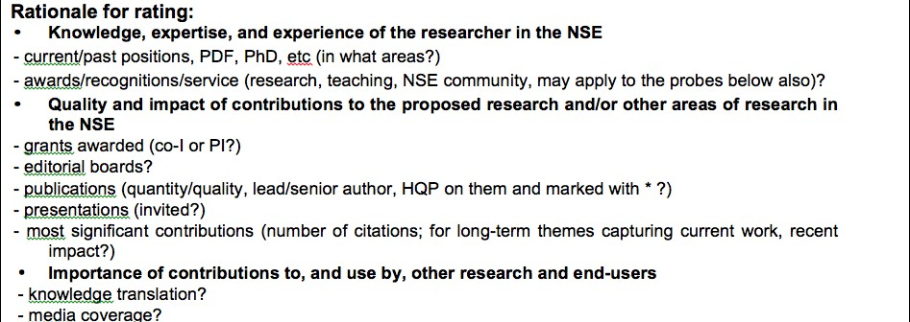
Excellence of Researcher
www.usask.ca

Slide 7
Merit of the Proposal
Now “where”

Slide 8
Training of HQP
www.usask
.ca
EDI of HQP! (see slides from our next 2 presenters)

Slide 9
Research Facilitators
Discovery Grants:
Danielle Baron, Ag & Bio
Tera Ebach, WCVM
Heidi Smithson, Engineering
Manisha Jalla, OVPR
HQP
EDI
CCV
Int. Review
www.usask.ca

Slide 10
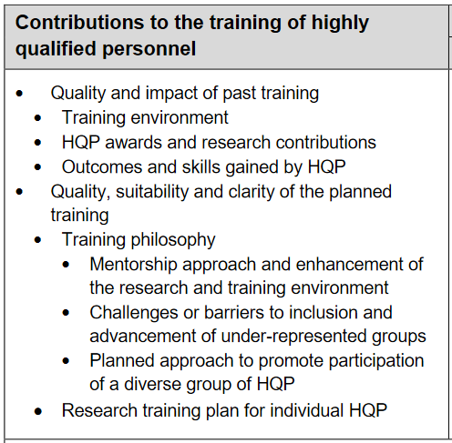
Training of HQP- – Danielle Baron
HQP Considerations (Appendix 5, 2022-23 Peer Review Manual)
Past training:
Don’t worry if you are an ECR and this is your first research program!
Undergrads, Masters, PhD, PDFs, technicians, research assistants, summer students
Highlight your lab facilities, specialized equipment/techniques, academic programs/training
Discuss past awards, presentations that HQP did
Where they are now – industry, academia – show that you have kept in touch!
Notes:
I am going to talk about what you need to include in the HQP sections of your proposal and the kinds of information the reviewers are looking for
The HQP component of your proposal is 1 of 3 merit indicators which ultimately decide whether your proposal is funded or not, and if it is funded your scores determine how much money you receive (the other two along with HQP are (1) Excellence of the Researcher and (2) Merit of the Proposal).
There are two sections you need to complete related to HQP in the proposal and they are both part of the online form you complete in the Research Portal. The two sections are CLICK (1) Past Contributions to HQP Training; and CLICK (2) your proposed Training plan. They are weighed equally in your HQP score, so 50/50.
This content in the box is directly from the HQP section of the Discovery Grants Rating form that the reviewers will use to indicate how they score you and the main points to take into consideration when assigning that score
First I am going to discuss the Past Training component. CLICK
If you are an established researcher or are renewing a DG this portion is fairly straight forward. Summarizing the numbers of UGs, grad students, PDFs,, etc. that you have supervised within the past 7 year window is always a good idea just to show the scope of your supervisory experience. You will want to Highlight the value-added components that your lab environment provides that supplement the student experience (such as special equipment, facilities, techniques, training programs). You should Discuss awards or accolades that past students have received and how many pubications or talks they have given. E..g, “past Hqp have pubished X papers in peer reviewed journals and given X conference talks/seminars”
If you are an ECR and don’t have much official supervisory experience, that’s ok – discuss all of the informal mentorship and supervision you have provided to students in past lab groups and provide specific examples of ways you have supported them.

Slide 11
Training of HQP- – Danielle Baron
HQP Considerations (Appendix 5, 2022-23 Peer Review Manual)
Training plan:
EDI
1) Training philosophy
Your approach to supervising students and mentorship
Team building, frequent (virtual) interactions, pedagogical approaches
2) Research training plan
Do not just list your HQP!
Describe specifically which HQP will be responsible for which aspects of the research and WHY
Ensure this is mirrored in your methods section in your proposal
Can include a Gantt chart in your budget just.
Use names where possible
Notes:
Now I am going to discuss the second half of the HQP score, the proposed Training Plan for the duration of your proposed DG. This is where you outline your mentorship philosophy as well as what your various HQP are going to be responsible for. This section is important for everyone, but it is especially crucial if you are an ECR or if you feel your past contributions to HQP training was a bit weak. Here you have the opportunity to make that up by having a well-thought out and detailed plan for your HQP.
I recommend dividing this section of your proposal into two parts CLICK, and actually using these headings to make them clear and separate: First, your training philosophy and second your research training plan.
Training philosphy;: CLICK
Your approach to supervising students and mentorship
Team building, frequent (virtual) interactions, pedagogical approaches
Don’t just say you have weekly lab meetings
This is also a place to discuss your EDI plan, which Tera is going to specifically talk about after I’m done with HQP, so I am not going to say anything about that
Research training plan: CLICK
Here is where you layout exactly what your HQP are going to do relative to your proposed program
Don’t just say I will have one Masters and one PhD student, for example, and generally say that they will each be included in all aspects of the research process. I see this a lot and it’s not enough.
You need to specifically link individual HQP to certain objectives for example, or if two HQP will work together on an objective or component you need to say that. It may seem obvious to you that you have laid out 4 short term objectives for your DG and you have 4 HQP, but it’s not obvious to readers. In this section you can relist your objectives and explicitly link individual HQP to them, along with the appropriate year or years. Explain exactly what they will be doing within each objective, and ensure that this information is mirrored in the methods section of your proposal document. Even including the HQP in parentheses when you are discussing the specific methods will be very helpful.
It’s also helpful if you are requesting funds for a PHD or PDF do justify why you require that level of training as opposed to putting a MSc or a a summer student on it.And you should include that information in your budget justification as well.
LASTLY, Use names where possible. If you don’t know who your students will be saying MSc1 and MSc2 is fine, but if you already have a student in mind, use their names and put MSc1 in parentheses.

Slide 12
Equity Diversity and Inclusion (EDI) NSERC Discovery Grants
EDI – Tera Ebach
Incorporate EDI throughout the grant
Clearly describe EDI challenges in the Institution/College & Field of Research
Include your own specific actions for HQP recruitment that address EDI Challenges.
Include your own specific actions to support an inclusive training environment
NSERC - NSERC guide on integrating equity, diversity and inclusion considerations in research (nserc-crsng.gc.ca)

Slide 13
Top Tips for CCV
CCV – Heidi Smithson
Start Early!
Use the NSERC CCV template (under Funded on the CV tab)
Follow the PDF Guide provided by NSERC in the NSERC template
Make good use of extra space
Mark your HQP with asterisks following their surnames
Visit the Grants Repository to see samples of CVs from past successful
applications (https://vpresearch.usask.ca/events/grants-calendar.php)
Contact your RF or RASI with questions or issues
Attend the fall CCV and DG application clinic (dates and times will be announced later in the summer).
www.usask.ca

Slide 14
Use the NSERC CV Template
To select the NSERC CCV template, choose ‘Funded’ under the CV tab, search for NSERC under funding source, then select NSERC_Researcher for CV Type.
www.usask.ca

Slide 15
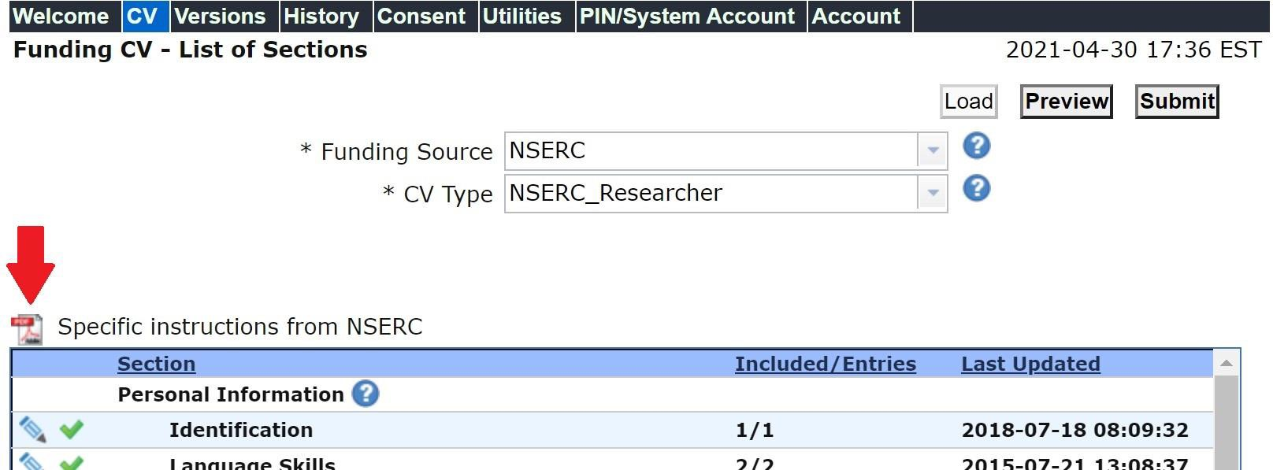
Follow the PDF provided by NSERC
www.usask.ca

Slide 16
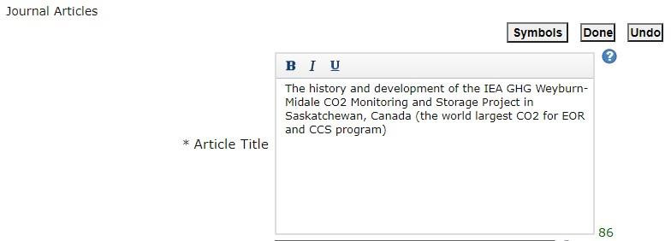
Make good use of extra space
Note that many of the text boxes in CCV have a lot of space. You can use this space to provide additional information about entries (e.g., award received for a paper, etc.)
www.usask.ca

Slide 17
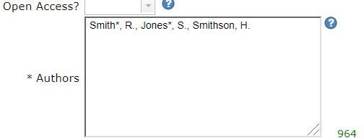
Mark your HQP with asterisks following their surnames
www.usask.ca

Slide 18
Internal Review – Manisha Jalla
DG-Evaluation Group | Faculty Name | Department and College | DG- Evaluation Group | Faculty Name | Department And College
 |  |  |  | Jasw ant Singh Joel Lanovaz | Veterinary Biomedical Sciences, WCVM College of Kinesiology
 | Susan Detmer Troy Harkness Meena Sakharkar Julia Boughner Yan Zhou Peter Bretscher Jack Gray Mirek Cygler Patrick Krone (Em eritus Professor) Daniel MacPhee | Veterinary Pathology, WCVM BMI, College of Medicine Pharmacy and Nutrition APP, College of Medicine VIDO BMI, College of Medicine Biology, Arts & Science BMI, College of Medicine Anatomy & Cell Biology, College of Medicine Veterinary Biomedical Sciences, WCVM
 |  |  | 1502: Biological Systems and Functions | John Howland Ron Borowsky Greg Penner Yangdou Wei Jack Gray | APP, College of Medicine Psychology, Arts and Science Animal and Poultry Science, AgBio Biology, Arts and Science Biology, Arts and Science
1501:Genes, Cells & Molecules |  |  | 1502: Biological Systems and Functions | John How land Ron Borow sky Greg Penner Yangdou Wei Jack Gray | APP, College of Medicine Psychology, College of Arts and Science Animal and Poultry Science, AgBio Biology, College of Arts and Science Biology, College of Arts and Science
1503: Evolution & Ecology | Robert Clark | Global Institute for Water Security |  | John P Giesy | Veterinary Biomedical Sciences, WCVM
1505: Physics | John Tse Alexander Moewes Andrei Smolyakov | Physics & Engg. Physics, Arts and Science Physics & Engg. Physics, Arts and Science Physics & Engg. Physics, Arts and Science
 |  |  | 1504: Chemistry | David Palmer Robert Scott | Chemistry, Arts and Science Chemistry, Arts and Science
 |  |  | 1506: Geosciences | Cherie Westbrook Adam Bourassa Yuanming Pan Steven Siciliano | Geography & Planning, Arts & Science Physics & Engg. Physics, Arts and Science Geological Sciences, Arts and Science Soil Sciences, AgBio
1507: Computer Science | Chanchal Roy Julita Vassileva Regan Mandryk Fangxiang Wu | Computer Science, Arts and Science Computer Science, Arts and Science Computer Science, Arts and Science Computer Science, Arts and Science; Mechanical Engineering, CoE
 |  |  | 1508: Math & Statistics | Raymond Spiteri Longhai Li Juxin Liu | Computer Science, Arts and Science Mathematics and Statistics, Arts and Science Mathematics and Statistics, Arts and Science
1511: Materials & Chemical Engineering | Ildiko Badea Ajay Dalai | Pharmacy and Nutrition Chemical and Biological Engineering, CoE
 |  |  | 1510: Electrical & Computer Engineering | Ramakrishna Gokaraju Safa O Kasap | Electrical and Computer Engineering, CoE Electrical and Computer Engineering, CoE
1512: Mechanical Engineering | Carey J Simonson James Johnston Xiongbiao Chen | Mechanical Engineering, CoE Mechanical Engineering, CoE Mechanical Engineering, CoE
www.usask.ca

Slide 19
Internal Review
RTI Evaluation Group | Faculty Name | Department and College
Genes, Cells & Molecules | Suresh Tikoo Thomas Fisher Wei Xiao Patrick Krone (Emeritus Professor) | School of Public Health, VIDO APP, College of Medicine BMI, College of Medicine Anatomy & Cell Biology, College of Medicine
Environmental Sciences | Robert Clark Christy Morrissey | Global Institute for Water Security School of Environment and Sustainability; Biology, College of Arts and Science; Toxicology Centre
Biological Systems and Functions | Jaswant Singh Valerie Thompson | Veterinary Biomedical Sciences, WCVM Psychology College of Arts and Science
Chemistry | Michel Gravel | Chemistry, College of Arts and Science
Materials & Chemical Engineering | Amira Abdelrasoul Qiaoqin Yang | Chemical and Biological Engineering, CoE Mechanical Engineering, CoE
Engineering | Ildiko Badea | College of Pharmacy and Nutrition
www.usask.ca

Slide 20
Internal Review
List of Researchers from USask who are currently holding (or have recently held NSERC Discovery Grant)
Please refer to this list while suggesting internal reviewers, if you are participating in the USask Internal Review Program.
www.usask.ca

Slide 21
Intention to apply (USask) NOI to NSERC
NSERC Discovery Grant (DG) and Research Tools and Instruments Grant (RTI) October / November 2023 Competitions
Internal Review and Submission Timelines
DG | RTI | REQUIREM ENT | DEADLINE
X | X | Applicants initiate their intention to apply and/or request for internal review by submitting the Intention to Apply/Request for Internal Review Form for NSERC DG/RTI to grant.review@usask.ca. Please put ‘Lastname NSERC DG/RTI’ in the subject heading. | Anytime before July 26, 2023
X |  | NSERC Deadline for Submission of DG Notification of Intent (NOI) to Apply NOI must be submitted to NSERC through the NSERC Research Portal. | Typically, August 1, 2023
X |  | Applicants participating in the internal review, please e-mail a copy of your submitted NSERC DG NOI to grant.review@usask.ca Please put ‘Lastname NSERC DG’ in the subject heading. | August 8, 2023
X | X | Applicants consult with their suggested reviewers, Research Facilitators, Associate/Vice-Deans Research, or mentorship teams to strategize and prepare their draf t application. | Anytime between now and September 12, 2023
X | X | Applicants submit draft DG and/or RTI application and CCV for internal rev iew to their internal reviewers, and copy to grant.review@usask.ca . Please put ‘Lastname NSERC DG/RTI’ in the subject heading. | September 13, 2023
X | X | Internal rev iews are returned to the applicants and copy to grant.review@usask.ca, directly from internal reviewers (or from grant.review@usask.ca if assistance is needed). | October 6, 2023
X | X | Applicants consult with their suggested reviewers, Research Facilitators, Associate/Vice-Deans Research, or mentorship teams to incorporate rev iewer f eedback. Research Facilitator reads for the logistical flow and completion of the proposal. | October 7 – 13 (RTI) October 7 – 20 (DG)
X | X | College/Unit Internal Approval Applicants must submit a full application package including CCV through Univ RSfor Department and College academic approval. Applicants comply with college/unit-specific internal approval processes and deadlines. | Please check with your Research Facilitator or Associate/Vice Dean Research/Director
 | X | Research Acceleration and Strategic Initiatives (RASI) Compliance Review and Approv al (RTI) College/school/unit of the applicant must review the application, decide on approv al and submit the decision in University Research System (UnivRS) at least 5 business days prior to the agency submission deadline. RSEO will rev iew f or eligibility, conduct a final compliance review check and prov ide Institutional approval. Applicants will have the opportunity to incorporate any required changes they wish to address or as noted by RASI. Paper applications will not be accepted. | October 18, 2023
Draft proposal for internal review(USask)
Compliance deadline
(RTI)
(ask your RF for earlier college/dept deadlines)
www.usask.ca

Slide 22
RTI deadlines
NSERC RTI Submission Deadline Final applications must be submitted by applicants to NSERC through the NSERC Research Portal, and will be forwarded by the RASI staff. | October 25, 2023
Research Acceleration and Strategic Initiatives (RASI) Compliance Review and Approval (DG) College/school/unit of the applicant must review the application, decide on approval and submit the decision in University Research System (UnivRS) at least 5 business days prior to the agency submission deadline. RSEO will review for eligibility, conduct a final compliance review check and provide Institutional approval. Applicants will have the opportunity to incorporate any required changes they wish to address or as noted by RASI. Paper applications will not be accepted. | October 25, 2023
NSERC DG Submission Deadline Final applications must be submitted by applicants to NSERC through the NSERC Research Portal, and will be forwarded by the RASI staff. | November 1, 2023
NSERC Discovery Grant/RTI Workshop: Workshop Highlights Specific strategies relevant to the merit indicators; Top tips and advice from: Research Facilitators on CCV, HQP, Equity, Diversity and Inclusivity (EDI) considerations, and Internal Review; Experienced NSERC Evaluation Group members regarding successful applications; • Session focused on RTI grants | May 16, 2023 Time: 1:00pm – 3:00 pm
Webinars and Information Sessions Calendar
EVENT | DATE
DG Webinar: Submission of a Notification of Intent to Apply (English) Live Q&A | TBA
RTI Webinar: Submission of an Application (English) | TBA
DG Webinar: Submission of an Application (English) | TBA
USask Q&A session for DG and RTI Applicants including information on CCV and Full Application in Research Portal | TBA
Compliance deadline (DG)
(ask your RF for earlier college/dept deadlines)
DG deadline
www.usask.
ca

Slide 23
DG Evaluation Group Members/Group Chair
Jaswant Singh, EG 1502 – Biological Systems and Functions
Robert Scott, EG 1504 – Chemistry
Raymond Spiteri (Group Chair), EG 1508 – Mathematics and Statistics
Ildiko Badea, EG 1511– Materials and Chemical Engineering
www.usask.ca

Slide 24
The Grid is our God during the Competition week
EG 1502:Biological Systems, Prof. Jaswant Singh
The Chair and Group members breath-in and live by the Grid!
R1 and R2 are your friends and advocates
Help them
As R1, I get only 3-4 minute to present your case!
What rationale would you like to appear on the Evaluation Form
Fill in the form for someone from USask database (i.e., understand the Grid)
Keep the story simple
Weaving the story between different sections (=multiple iterations)
Keep CIHR domains out
What specific EDI actions have you taken? Keep CIHR domains out
What specific EDI actions are you taking?
Notes:
Decide your long-term goal (15-20 year) and short-term objectives (5 year) by the end of today
As a reviewer, I got >40 applications last year - 10 as R1. As an R1, I spend about 2 to 3 hours on each applicant and as a R4 or R5, about 30-45 minutes. Give me the info in “ready-to-use” form.

Slide 25
EG 1504:Chemistry, Prof. Rob Scott
Some of the issues I noted the past several years that led to poorer outcomes:
Description of EDI challenges in both your field of research and institution. Explicitly state what these challenges are for both, and provide several concrete action plans.
Most Significant Contributions to Research: These should be used to describe your expertise and the impact of your work, and need not be publication specific (i.e. they should not be paper abstracts). Be specific about evidence of the impact of your work – i.e. your expertise has led to invited talks/publications/grants/awards/collaborations, etc.
Collaborations: Many people collaborate, but it is incumbent to describe your role in all collaborations. If you publish with other co-PIs often, be explicit about what your role is.
Delays in Research: Quantify your delays. NSERC allows you to attach a supplementary contributions to research document. Only a minority of applicants take advantage of this.
www.usask.ca

Slide 26
EG 1508:Math & Stats, Prof. Raymond Spiteri (Group Chair)
Start early!
Read the instructions; follow the instructions.
Get feedback.
“The onus is on the applicant.”
Clearly explain your role in publications, supervision, collaborations, committees, other funding.
Ensure consistency between CCV and application.
Don’t take EDI lightly.
No matter how clear things are in your mind, do not assume reviewers can read it.
Write in plain language for the educated non-specialist.
Less can be more, but sometimes less is just less.
Have fun! Have your excitement/enthusiasm come through!
www.usask.ca

Slide 27
EG 1511: Materials and Chemical Engineering, Prof. Ildiko Badea
Read thoroughly NSERC guidelines and the Grid
Read previous awarded applications
Made sure all points are addressed in the application (HQP past training and plan seems important for this EG).
Training HQP – past strategies to support future recruitment, addressing EDI
www.usask.ca

Slide 28
Q&A: Discovery Grants
Please either type your question into the chat, or raise your hand!

Slide 29
RTI: Evaluation Group Members
RTI: Research Facilitators
Heidi Smithson, Engineering
Michel Gravel, RTI Evaluation Group: Chemistry
Suresh Tikoo - RTI Evaluation Group Genes, Cells and Molecules
www.usask.ca

Slide 30
Research Tools and Instruments (RTI) – Heidi Smithson
Reviewed 29 RTI applications beginning from 2016/17 – 2020/21
Number of Co-Applicants | Total # applications in category | % of total applications | # of successful applications | Success rate as % of total applications | % of awarded vs. total in category | % of total successful applications
0 | 9 | 31% | 0 | 0 | 0 | 0
1 | 4 | 14% | 1 | 3.4% | 25% | 12.5%
2 | 9 | 31% | 1 | 3.4% | 11% | 12.5%
3+ (usually 4+) | 7 | 24% | 6 | 20.6% | 85% | 75%

Slide 31
Characteristics of Successful RTIs
Characteristic | Details
Excellence of the Researcher(s) | PI and Co-Is are highly funded; have large HQP teams and outputs
Usage | Applications with multiple applicants show much higher usage rates in the proposals; successful applications provide a detailed usage and management plan, including time built in for other users (internal and external, with specific other users identified).
Linked to other funding success | Successful applications emphasize a direct link between equipment and success on other programs such as meeting DG objectives
Multidisciplinary/Interdisciplinary | Co-Is from at least other departments and usually other colleges; wide range of research areas in a single application
Collaboration History | Teams tend to have multiple co-authored publications and jointly-held funding
Funds Requested | Full or close to full $150,000 requested (vs. very low success rates below $100,000)
# HQP trained | Applications with multiple applicants have significantly more HQP to be trained (e.g., over 20 HQP/yr vs. fewer than 10 over 6 years)

Slide 32
Characteristics of Unsuccessful RTIs
Characteristic | Details
Excellence of the Researcher(s) | Limited array of funding sources; fewer collaborations
Usage | Limited usage – likely due to single or small number of Co-Is (e.g., PI will use 100% of time but only 10 hrs/month); vague reference to other users or possible future collaborations (all unnamed)
Links to other funding success | Limited/lacking reference to success of other funding
Multidisciplinary/ Interdisciplinary | Challenging to demonstrate exposure of HQP to multidisciplinary environment as a lone applicant or small team with limited collaboration history
Collaboration History | Limited/lacking collaboration history among the team members
Funds Requested | Small amount of funding requested ($20,000 – 40,000); likely just an indicator of other problems in the proposal
# HQP trained | Limited # of HQP to be trained; often the number of expected HQP doesn’t align with past training numbers
Language | Significant time spent describing the research/overly technical

Slide 33
What does all of this mean?
Larger teams fair better because:
They can demonstrate significantly more use and impact
They train more HQP
They can demonstrate more collaboration and multidisciplinarity
The size of the team ensures each section of the proposal is more succinct and less technical

Slide 34
Cont’
Smaller dollar value proposals:
Tend to be single applicants or small teams
Seem to be less polished
Excellence of the Researcher(s)
This does appear to have some import, but it is not the whole story as sometimes the same excellent applicants are not funded.
The proposal still needs to have the other qualities mentioned.

Slide 35
Tips
Start working early to give yourself lots of time to put together a larger team or identify (confirm) other users
Work with your Research Facilitator to help identify potential collaborators in other units
If you’re a single applicant or small team, don’t feel compelled to fill up all the pages. Keep the writing succinct, specific, and not overly technical.
If you’re asking for a small dollar amount, put the same effort in as you would for the full $150,000.
Smaller teams need to be realistic about number of HQP trained (compensate by identifying other users)
Find and follow examples in the Grants Repository. You can adapt the qualities of a larger-team proposal to a small one.

Slide 36
Tips for a Successful RTI Application
Research Tools and Instruments (RTI) – Prof. Michel Gravel
Need, urgency and suitability (40%)
Demonstrate instrument is essential and not currently available
Intensive use of instrument: # of users, # hours/month
Shared instrument: # of applicants, # of users
Feasibility and impact (40%)
Excellence of research program and of applicant
EDI in team composition (applicants)
Training of HQP (20%)
Quality and importance of training on this instrument
Shared instrument: # of applicants, # of users
EDI in users
Assessment Notes Template: RTI

Slide 37
Research Tools and Instruments (RTI) – Prof. Suresh Tikoo
Information is on Next Slide

Slide 38
1. Need , urgency and suitability (40%);
A)
The equipment is essential for the research and there is no other most cost-effective ways of obtaining the results)
important for research, ✓ HQP training
number of users to be benefited
If yes-----justify
B) Availability of similar equipment/facilities/services in the vicinity;
✪ Functioning equipment (✓ # of users, ✓ feasibility of moving samples, ✓ limited access to the instrument, ✓ drawback in existing Equip.
✪ Replace failed equipment ✓(need costly repair every 3-6 months, ✓ no availability of parts)
✪ Upgrade or replace obsolete instrument. (✓ new analysis software, ✓ changed technology)
C) Impact of delay in acquisition of equipment
on research and pace of research
delay in publication ✓ delay creates problem with existing/ future collaborations; ✓building competitive research program.
delay in HQP training /completion ✓ force HQP to work irregular hrs (without supervision)
D)
Degree of utilizations.
as many researchers / HQP as possible
2. Feasibility and Impact (40%)
A)
Quality and significance of research programs, potential for major advances and impact in the discipline
✪ Team: ✓ Avoid member with well funded human health research . ✪ Simple language ✓ reviewer may not be from your area)
✪ Advances / impact ✓ Immediate impact --- Scientific ; ✓ long run Impact. ---economic potential
B)
Feasibility of the plan to use equipment.
Supervised (may be by an appointed technician), ✓ separate accessible space;
Time booking system, ✓ user fee (future repairs, partial salary etc); ✓ ordering system
C) Existing experience or training plan for applicants to use the system. ✓( PI & technician well trained).
D) EDI
✪ Team / applicants ✓ Gender, ✓ minority, ✓ Indigenous etc-----------------(Not considered for allotting marks)
3. Training of HQP. (20%)
A) Quality & extent of training
✪ Past ✓ HQP Track record ✪. Future. ✓ Help increase HQP #
B) Opportunity for hands on training:
Beneficial if industry involved, ✓ Senior HQP /technician provide training ✓ Need Training plan
C) Potential to provide marketable skills for trained students
D) EDI ✪ Emphasis need to be
Plan to host indigenous students for recruiting,
Representing different countries with diverse ethnicity.
MOU /access to indigenous community
Female HQP recruitment
# | 10% | 20% |  | 30% |  | 30% |  | 20% |  | 10%
Score | 1 | 2 | 3 | 4 | 5 | 6 | 7 | 8 | 9 | 10

Slide 39
Q&A: RTI Grants
Please either type your question into the chat, or raise your hand!

Slide 40
Application Preparation Resources
NSERC Resources:
NSERC Instructions http://www.nserc-crsng.gc.ca/ResearchPortal- PortailDeRecherche/Instructions-Instructions/DG-SD_eng.asp
NSERC Presentation Standards (fonts, margins etc.) are at: http://www.nserc-crsng.gc.ca/OnlineServices- ServicesEnLigne/pdfatt2_eng.asp
NSERC Webinars: http://www.nserc-crsng.gc.ca/ResearchPortal-
PortailDeRecherche/RP-CCV-Webinar_eng.asp
NSERC resource videos http://www.nserc-crsng.gc.ca/ResearchPortal- PortailDeRecherche/Resource-Informatives_eng.asp
www.usask.ca

Slide 41
Application Preparation Resources
USask Resources:
USask Grants repository
Grants Repository - Home (sharepoint.com)
Videos and slides from our previous NSERC grant workshops
Tri-Council Research Support - Office of the Vice President Research - Research | University of Saskatchewan (usask.ca)
Comprehensive list of resources available for the EDI component of your Discovery Grant application:
https://usaskca1-my.sharepoint.com/:w:/g/personal/maj944_usask_ca/EYGxUNh9HdZNhcWOjgrMZpgBpjpmZ1L6ryF5icyVf9vFIg?e=HENzqh
www.usask.ca
•

Slide 42
NSERC Research Facilitation & Planning Team
NSERC Leader: Ron Borowsky
Research Development Specialist, Office of Vice President Research: Manisha Jalla
Research Development Specialist, Office of Vice President Research :, Elmira Jafarieh Yazdi
Research Facilitators
Agriculture and Bioresources: Danielle Baron
Arts and Science: Colleen Cochran
Engineering: Heidi Smithson
Dentistry and School of Public Health: Janice Michael
Kinesiology/Pharmacy and Nutrition: Gen Clark
Medicine: Biomedical Departments (BMI, APP) : Bruna Bonavia-Fisher; Department of Medicine: Ozlem Sari Department of Surgery: Karen Mosier ; Department of Pediatrics: Tova Dybvig
Department of Psychiatry: Mariam Alaverdashvili ; Departments of Family Medicine, Medical Imaging, Obstetrics & Gynecology, Oncology, Ophthalmology, Pathology and Laboratory Medicine: Mark Milne
Western College of Veterinary Medicine: Tera Ebach
School of Environment and Sustainability: Graham Fairhurst
Research Acceleration and Strategic Initiatives (Large Scale Grants) : James Dobson
www.usask.ca

Slide 43
Research Support Specialists, Research Acceleration and Strategic Initiatives
Colleges / Schools | Name
Arts and Science Education Edwards School of Business School of Public Policy Law Library Centre for Forensic Behavioural Science and Justice Studies Centre for the Study of Co-operatives Community-University Institute for Social Research (CUISR) | Nicole Benning
 | Laurie Schimpf
Agriculture and Bioresources Engineering Global Institute for Food Security Global Institute for Water Security School of Environment and Sustainability Toxicology Centre Vaccine & Infectious Disease Organization Western College of Veterinary Medicine | Brenda Meyer-Burt
 | Gerelt Trost
Medicine Pharmacy and Nutrition Nursing; Dentistry Kinesiology School of Public Health Saskatchewan Population Health and Evaluation Research Unit (SPHERU) Canadian Centre for Health and Safety in Agriculture (CCHSA) Indigenous Peoples' Health Research Centre | Cameron Berg
 | Centaine Raginski
www.usask.ca

