Slide 1
NSERC Fall Workshop – September 28, 1:30 – 3:30 PM
We acknowledge that we live and work on Treaty 6 Territory and the Homeland of the Métis. We pay our respect to the First Nations and Métis ancestors of this place and reaffirm our relationship with one another.
~ Please note: this workshop is being recorded.
1:30 – 1:45 Welcome, Merit Grid and Ratings Reminders – Ron Borowsky
1:45 – 2:05 Research Portal – Danielle Baron
2:05 – 2:20 CCV – Heidi Smithson
2:20 – 2:35 Equity Diversity and Inclusion – Tera Ebach
2:35 – 2:37 Internal Review – Elmira Yazdi
2:37 – 3:10 Q & A

Slide 2
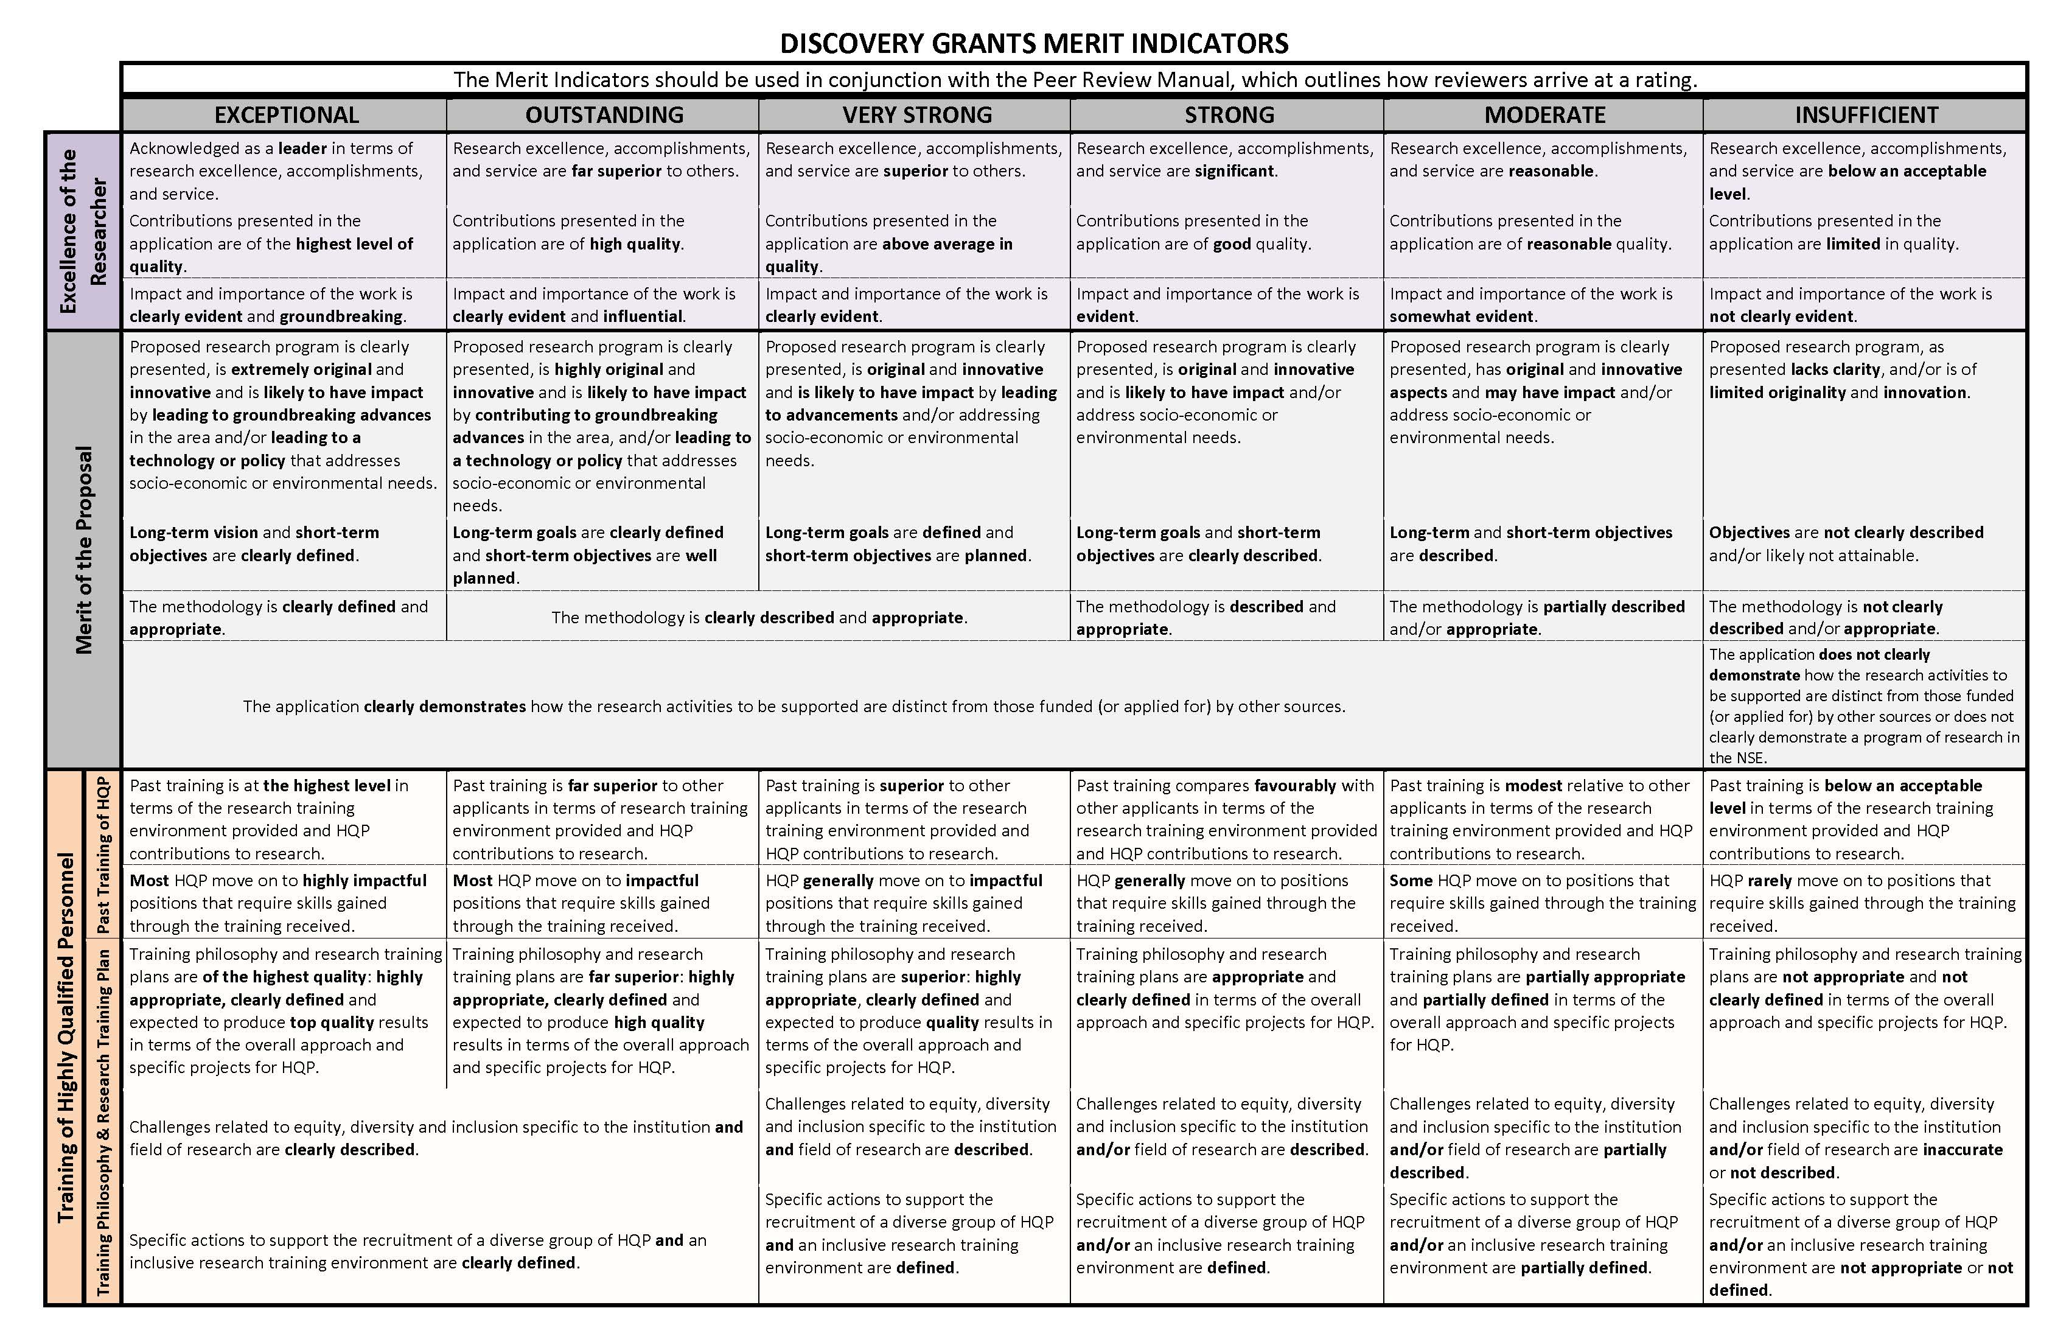
The Merit “Grid”

Slide 3
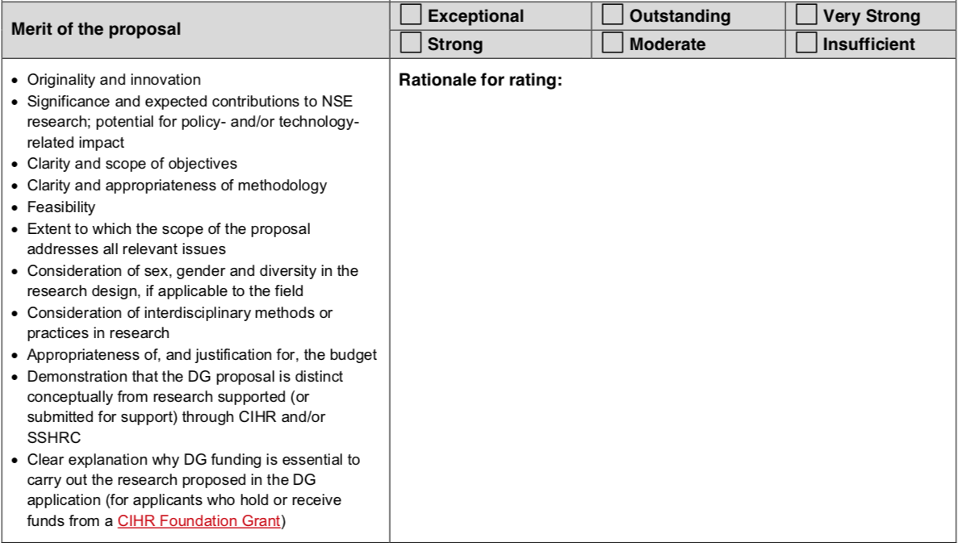
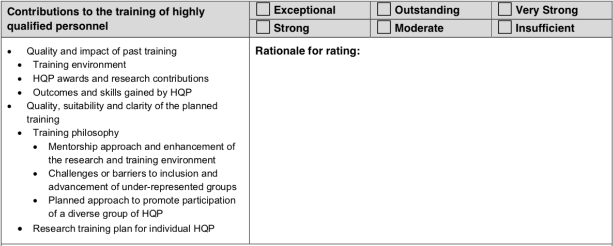
NSERC DG Rating Form – Ron Borowsky
Now “where”
￼
EDI of HQP! (see slides from our next 2 presenters)

Slide 4
Excellence of Researcher

Slide 5
Merit of the Proposal
Now “where”

Slide 6
Training of HQP
EDI of HQP! (see slides from our next 2 presenters)

Slide 7
Research Portal

Slide 8
Top Tips for CCV
Start Early!
Use the NSERC CCV template (under Funded on the CV tab)
Follow the PDF Guide provided by NSERC in the NSERC template
Make good use of extra space
Mark your HQP with asterisks following their surnames
Visit the Grants Repository to see samples of CVs from past successful applications (https://vpresearch.usask.ca/events/grants-calendar.php)
Contact your RF or RASI with questions or issues
Attend the fall CCV and DG application clinic (dates and times will be announced later in the summer).

Slide 9
To start a new CV, choose either Funding or Generic under the CV tab to open the template to begin building your CV.
Tip: “Funding” allows you to choose the specific template for the particular agency you are applying to. Unless you typically apply to many different funding agencies that use CCV, you will save a lot of time and trouble by just selecting the specific funding CV rather than the Generic CV. Anything entered in the specific funding CV is automatically entered in the generic version.

Slide 10
Once you’ve selected and loaded the NSERC CCV template, some fields will already be filled from your registration information or past CCVs.
Items with green checkmarks have all required fields filled in. This does not necessarily mean that they are complete. There might be additional details you want to add within these. Also, if you have had a previous CCV, you might need to update details such as contact information.

Slide 11
Note that NSERC provides detailed instructions on what they expect to see in each field in the embedded PDF.
Items with red X’s have incomplete fields or fields with errors. A common error is a contribution entry that is older than 6 years. NSERC limits contributions in the CV to only those in the past 6 years.

Slide 12
To remove publications that you don’t want to include in the current CV, simply ‘uncheck’ the box. If you use ‘Trash’ to remove them, you will be deleting them completely from the CCV system, and they will no longer be available for future CCV templates.

Slide 13
Tip: Always use the ‘Done’ button to get out of a specific page. Using back on your browser may cause any changes you’ve made to be lost.

Slide 14
Note that many of the text boxes in CCV have a lot of space. You can use this space to provide additional information about entries (e.g., award received for a paper, etc.)

Slide 15
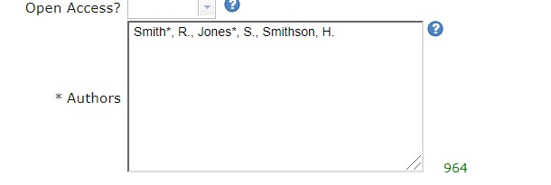
Mark your HQP with an asterisk following their surnames:

Slide 16
Importing Publications
If you have a Google Scholar, Web of Science, ORCiD, Scopus or another similar profile that compiles your publications, you can import them into the CCV from one of these sites, saving you the trouble of inputting publications individually.

Slide 17
First, export your publications in the profile you choose (e.g., Scopus) to a Bibtex file. Then, in your CCV, under the Utilities tab, select Import Publication from File. This will open a screen where you can select the database (e.g., Google Scholar) from which you imported the publications and select and import the file you saved.

Slide 18
Once you’ve successfully imported your publications, you will need to correct any of the information automatically generated for them (e.g., publication type). Also, uncheck any publications you don’t want to import. When you’re ready, select Confirm Import. Then, you will need to re-load your CV by selecting the same CV type under the CV tab. You will likely have X’s beside the new entries because not all of the required data can be imported, but the missing information is usually just selecting whether or not the article was peer reviewed.
Tip: This process will duplicate any existing publication in the CCV system, so be sure to uncheck any publications you already have entered.

Slide 19
Once your CV is completed and there are no errors or Xs to correct, click the submit button.

Slide 20
Clicking Submit generates a warning screen for you to read. You have to click the I Agree button to proceed.

Slide 21
Once you’ve clicked “I Agree”, you will receive a message that provides you with a confirmation number. In your application on the NSERC Portal, you will be asked to provide this confirmation number. This will link your CCV to your application. If you make changes to the CCV after linking it, you will receive a new confirmation number and will need to relink your CCV in the NSERC Portal using the new confirmation number.
Tip: Use the same email in the CCV as you use for NSERC. Otherwise, the CV may not be linked to your application on the Portal.

Slide 22
Where to get help…
Each agency is responsible for providing assistance with its own CCV templates, so use the contact information for NSERC that is provided under the Contact Us tab in the CCV for technical assistance.
For other assistance, please contact your College Research Facilitator or your Research Support Specialist: http://research.usask.ca/staff-directory/index.php

Slide 23
Final Tip
Close to the proposal submission deadline, the CCV encounters heavy traffic and can have problems or long periods of lag or may even go offline. So, it is advisable to complete your CCV well ahead of your submission deadline.

Slide 24
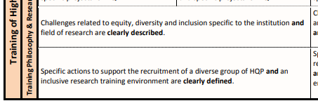
Equity Diversity and Inclusion (EDI) Discovery Grants Merit Indicators
www.usask.ca

Slide 25
Equity Diversity and Inclusion (EDI) on Discovery Grants
Describe Institution or College EDI challenges.
Describe field of research EDI challenges.
Review USask commitments for EDI recruitment that address Institution challenges.
Develop your own specific EDI recruitment practices that address both USask and discipline EDI challenges include this in your application.
Review USask resources for an inclusive research training environment that address EDI challenges.
Develop your own specific training plan practices that address USask and field EDI challenges include this in your application
Sex and Gender in research design
www.usask.ca

Slide 26
EDI Challenges for the Institution
Use EDI information on the RASI website
Work with facilitators and EDI specialists
USask priorities include Indigenization (Embrace Manacihitowin)
Systemic barriers NFRF information
The 2018 report published by the Canadian Association of University Teachers, Underrepresented and Underpaid: Diversity & Equity Among Canada’s Postsecondary Education Teachers, highlights the persistent lack of diversity in the academic workforce, and wage gaps between men and women, and between white and Indigenous and racialized staff.

Slide 27
EDI challenges in Discipline
Contact research facilitator for your college or EDI specialist
Review Association websites
Example Engineering – Enrollment of women
www.usask.ca

Slide 28
Specific Actions for Recruiting a Diverse HQP group
What is USask doing to address institutional challenges?
What specific action item can you include to address institutional challenges?
In your discipline, what specific action can you take to address this challenge for recruitment?
www.usask.ca

Slide 29
Specific Actions for an Inclusive Research Training Environment
What resources does USask have that you can use to address EDI challenges in your training plan
What actions can you take to address the EDI challenges in your discipline in your training plan
SMART EDI plans –Specific, Measurable, Achievable Relevant and Time-Bound
www.usask.ca

Slide 30
EDI Example for Application
Team members and new students will complete USask’s unconscious bias training within the 1st month of starting, as beliefs we have about certain groups can operate outside our conscious awareness and lead to decisions that contribute to inequality. Specific action item for inclusion which can be measured.
The X Association indicates a high percentage of the students identify as white. As part of the recruitment process, we will seek HQP candidates from visible minorities by working with professional associations for minority groups such as the American Association of X field Latin group and asking them to post positions in their network. EDI challenge in the field of research and a specific action to address recruitment.
A code of conduct and EDI strategy for the lab is posted on our website. As part of our EDI strategy to support students' participation and inclusion in the lab and at social events, we offer; child-friendly venues, flexible work hours, diverse dietary choices, support to attend conferences, and student stipends above the suggested minimum. Specific action items for recruitment and inclusion.
www.usask.ca

Slide 31
Sex and Gender in Research Design
Rationale and methodology for including sex, gender and diversity in the research design are clearly described; and
Aspects of sex (biological), gender (socio-cultural) and diversity are addressed in the research design, making it more ethically sound, rigorous and useful
www.usask.ca

Slide 32
Resources
NSERC EDI guide for applicants- NSERC - NSERC guide on integrating equity, diversity and inclusion considerations in research (nserc-crsng.gc.ca)
NFRF EDI https://www.sshrc-crsh.gc.ca/funding-financement/nfrf-fnfr/edi- eng.aspx#3
RASI EDI https://vpresearch.usask.ca/rasi/resource-hub/edi-equity-diversity- inclusion.php
EDI- Recruitment https://jira.usask.ca/servicedesk/customer/kb/view/1346961465?q=Equity%2C+Div ersity%2C+and+Inclusion+%28EDI%29+in+Recruitment
EDI Framework-https://www.nserc-crsng.gc.ca/NSERC-CRSNG/EDI- EDI/framework_cadre-de-reference_eng.asp
www.usask.ca

Slide 33
Internal Review
DG-Evaluation Group | Faculty Name | Department and College | DG- Evaluation Group | Faculty Name | Department and College
 | Susan Detmer Troy Harkness Meena Sakharkar Julia Boughner Yan Zhou Peter Bretscher Jack Gray Mirek Cygler Patrick Krone (Em eritus Professor) Daniel MacPhee | Veterinary Pathology, WCVM BMI, College of Medicine Pharmacy and Nutrition APP, College of Medicine VIDO BMI, College of Medicine Biology, Arts & Science BMI, College of Medicine Anatomy & Cell Biology, College of Medicine Veterinary Biomedical Sciences, WCVM |  | Jasw ant Singh Joel Lanovaz | Veterinary Biomedical Sciences, WCVM College of Kinesiology
 |  |  | 1502: Biological Systems and Functions | John Howland Ron Borowsky Greg Penner Yangdou Wei Jack Gray | APP, College of Medicine Psychology, Arts and Science Animal and Poultry Science, AgBio Biology, Arts and Science Biology, Arts and Science
1501:Genes, Cells & Molecules |  |  | 1502: Biological Systems and Functions | John How land Ron Borow sky Greg Penner Yangdou Wei Jack Gray | APP, College of Medicine Psychology, College of Arts and Science Animal and Poultry Science, AgBio Biology, College of Arts and Science Biology, College of Arts and Science
1503: Evolution & Ecology | Robert Clark | Global Institute for Water Security |  | John P Giesy | Veterinary Biomedical Sciences, WCVM
1505: Physics | John Tse Alexander Moewes Andrei Smolyakov | Physics & Engg. Physics, Arts and Science Physics & Engg. Physics, Arts and Science Physics & Engg. Physics, Arts and Science
 |  |  | 1504: Chemistry | David Palmer Robert Scott | Chemistry, Arts and Science Chemistry, Arts and Science
 |  |  | 1506: Geosciences | Cherie Westbrook Adam Bourassa Yuanming Pan Steven Siciliano | Geography & Planning, Arts & Science Physics & Engg. Physics, Arts and Science Geological Sciences, Arts and Science Soil Sciences, AgBio
1507: Computer Science | Chanchal Roy Julita Vassileva Regan Mandryk Fangxiang Wu | Computer Science, Arts and Science Computer Science, Arts and Science Computer Science, Arts and Science Computer Science, Arts and Science; Mechanical Engineering, CoE
 |  |  | 1508: Math & Statistics | Raymond Spiteri Longhai Li Juxin Liu | Computer Science, Arts and Science Mathematics and Statistics, Arts and Science Mathematics and Statistics, Arts and Science
1511: Materials & Chemical Engineering | Ildiko Badea Ajay Dalai | Pharmacy and Nutrition Chemical and Biological Engineering, CoE
 |  |  | 1510: Electrical & Computer Engineering | Ramakrishna Gokaraju Safa O Kasap | Electrical and Computer Engineering, CoE Electrical and Computer Engineering, CoE
1512: Mechanical Engineering | Carey J Simonson James Johnston Xiongbiao Chen | Mechanical Engineering, CoE Mechanical Engineering, CoE Mechanical Engineering, CoE
DG-Evaluation Group | Faculty Name | Department and College | DG- Evaluation Group | Faculty Name | Department And College
 | Susan Detmer Troy Harkness Meena Sakharkar Julia Boughner Yan Zhou Peter Bretscher Jack Gray Mirek Cygler Patrick Krone (Em eritus Professor) Daniel MacPhee | Veterinary Pathology, WCVM BMI, College of Medicine Pharmacy and Nutrition APP, College of Medicine VIDO BMI, College of Medicine Biology, Arts & Science BMI, College of Medicine Anatomy & Cell Biology, College of Medicine Veterinary Biomedical Sciences, WCVM |  | Jasw ant Singh Joel Lanovaz | Veterinary Biomedical Sciences, WCVM College of Kinesiology
 |  |  | 1502: Biological Systems and Functions | John Howland Ron Borowsky Greg Penner Yangdou Wei Jack Gray | APP, College of Medicine Psychology, Arts and Science Animal and Poultry Science, AgBio Biology, Arts and Science Biology, Arts and Science
1501:Genes, Cells & Molecules |  |  | 1502: Biological Systems and Functions | John How land Ron Borow sky Greg Penner Yangdou Wei Jack Gray | APP, College of Medicine Psychology, College of Arts and Science Animal and Poultry Science, AgBio Biology, College of Arts and Science Biology, College of Arts and Science
1503: Evolution & Ecology | Robert Clark | Global Institute for Water Security |  | John P Giesy | Veterinary Biomedical Sciences, WCVM
1505: Physics | John Tse Alexander Moewes Andrei Smolyakov | Physics & Engg. Physics, Arts and Science Physics & Engg. Physics, Arts and Science Physics & Engg. Physics, Arts and Science
 |  |  | 1504: Chemistry | David Palmer Robert Scott | Chemistry, Arts and Science Chemistry, Arts and Science
 |  |  | 1506: Geosciences | Cherie Westbrook Adam Bourassa Yuanming Pan Steven Siciliano | Geography & Planning, Arts & Science Physics & Engg. Physics, Arts and Science Geological Sciences, Arts and Science Soil Sciences, AgBio
1507: Computer Science | Chanchal Roy Julita Vassileva Regan Mandryk Fangxiang Wu | Computer Science, Arts and Science Computer Science, Arts and Science Computer Science, Arts and Science Computer Science, Arts and Science; Mechanical Engineering, CoE
 |  |  | 1508: Math & Statistics | Raymond Spiteri Longhai Li Juxin Liu | Computer Science, Arts and Science Mathematics and Statistics, Arts and Science Mathematics and Statistics, Arts and Science
1511: Materials & Chemical Engineering | Ildiko Badea Ajay Dalai | Pharmacy and Nutrition Chemical and Biological Engineering, CoE
 |  |  | 1510: Electrical & Computer Engineering | Ramakrishna Gokaraju Safa O Kasap | Electrical and Computer Engineering, CoE Electrical and Computer Engineering, CoE
1512: Mechanical Engineering | Carey J Simonson James Johnston Xiongbiao Chen | Mechanical Engineering, CoE Mechanical Engineering, CoE Mechanical Engineering, CoE
www.usask.ca

Slide 34
Internal Review
RTI Evaluation Group | Faculty Name | Department and College
Genes, Cells & Molecules | Suresh Tikoo Thomas Fisher Wei Xiao Patrick Krone (Emeritus Professor) | School of Public Health, VIDO APP, College of Medicine BMI, College of Medicine Anatomy & Cell Biology, College of Medicine
Environmental Sciences | Robert Clark Christy Morrissey | Global Institute for Water Security School of Environment and Sustainability; Biology, College of Arts and Science; Toxicology Centre
Biological Systems and Functions | Jaswant Singh Valerie Thompson | Veterinary Biomedical Sciences, WCVM Psychology College of Arts and Science
Chemistry | Michel Gravel | Chemistry, College of Arts and Science
Materials & Chemical Engineering | Amira Abdelrasoul Qiaoqin Yang | Chemical and Biological Engineering, CoE Mechanical Engineering, CoE
Engineering | Ildiko Badea | College of Pharmacy and Nutrition
www.usask.ca

Slide 35
Internal Review
List of Researchers from USask who are currently holding (or have recently held NSERC Discovery Grant)
Please refer to this list while suggesting internal reviewers, if you are participating in the USask Internal Review Program.
www.usask.ca

Slide 36
Intention to apply (USask) NOI to NSERC
NSERC Discovery Grant (DG) and Research Tools and Instruments Grant (RTI) October / November 2023 Competitions
Internal Review and Submission Timelines
DG | RTI | REQUIREM ENT | DEADLINE
X | X | Applicants initiate their intention to apply and/or request for internal review by submitting the Intention to Apply/Request for Internal Review Form for NSERC DG/RTI to grant.review@usask.ca. Please put ‘Lastname NSERC DG/RTI’ in the subject heading. | Anytime before July 26, 2023
X |  | NSERC Deadline for Submission of DG Notification of Intent (NOI) to Apply NOI must be submitted to NSERC through the NSERC Research Portal. | Typically, August 1, 2023
X |  | Applicants participating in the internal review, please e-mail a copy of your submitted NSERC DG NOI to grant.review@usask.ca Please put ‘Lastname NSERC DG’ in the subject heading. | August 8, 2023
X | X | Applicants consult with their suggested reviewers, Research Facilitators, Associate/Vice-Deans Research, or mentorship teams to strategize and prepare their draf t application. | Anytime between now and September 12, 2023
X | X | Applicants submit draft DG and/or RTI application and CCV for internal rev iew to their internal reviewers, and copy to grant.review@usask.ca . Please put ‘Lastname NSERC DG/RTI’ in the subject heading. | September 13, 2023
X | X | Internal rev iews are returned to the applicants and copy to grant.review@usask.ca, directly from internal reviewers (or from grant.review@usask.ca if assistance is needed). | October 6, 2023
X | X | Applicants consult with their suggested reviewers, Research Facilitators, Associate/Vice-Deans Research, or mentorship teams to incorporate rev iewer f eedback. Research Facilitator reads for the logistical flow and completion of the proposal. | October 7 – 13 (RTI) October 7 – 20 (DG)
X | X | College/Unit Internal Approval Applicants must submit a full application package including CCV through Univ RSfor Department and College academic approval. Applicants comply with college/unit-specific internal approval processes and deadlines. | Please check with your Research Facilitator or Associate/Vice Dean Research/Director
 | X | Research Acceleration and Strategic Initiatives (RASI) Compliance Review and Approv al (RTI) College/school/unit of the applicant must review the application, decide on approv al and submit the decision in University Research System (UnivRS) at least 5 business days prior to the agency submission deadline. RSEO will rev iew f or eligibility, conduct a final compliance review check and prov ide Institutional approval. Applicants will have the opportunity to incorporate any required changes they wish to address or as noted by RASI. Paper applications will not be accepted. | October 18, 2023
Draft proposal for internal review(USask)
Compliance deadline
(RTI)
(ask your RF for earlier college/dept deadlines)
www.usask.ca

Slide 37
RTI deadlines
NSERC RTI Submission Deadline Final applications must be submitted by applicants to NSERC through the NSERC Research Portal, and will be forwarded by the RASI staff. | October 25, 2023
Research Acceleration and Strategic Initiatives (RASI) Compliance Review and Approval (DG) College/school/unit of the applicant must review the application, decide on approval and submit the decision in University Research System (UnivRS) at least 5 business days prior to the agency submission deadline. RSEO will review for eligibility, conduct a final compliance review check and provide Institutional approval. Applicants will have the opportunity to incorporate any required changes they wish to address or as noted by RASI. Paper applications will not be accepted. | October 25, 2023
NSERC DG Submission Deadline Final applications must be submitted by applicants to NSERC through the NSERC Research Portal, and will be forwarded by the RASI staff. | November 1, 2023
NSERC Discovery Grant/RTI Workshop: Workshop Highlights Specific strategies relevant to the merit indicators; Top tips and advice from: Research Facilitators on CCV, HQP, Equity, Diversity and Inclusivity (EDI) considerations, and Internal Review; Experienced NSERC Evaluation Group members regarding successful applications; • Session focused on RTI grants | May 16, 2023 Time: 1:00pm – 3:00 pm
Webinars and Information Sessions Calendar
EVENT | DATE
DG Webinar: Submission of a Notification of Intent to Apply (English) Live Q&A | July 4, 2023
RTI Webinar: Submission of an Application (English) | September 5, 2023 September 28, 2023
DG Webinar: Submission of an Application (English) | August 22, 2023 September 21, 2023
USask Q&A session for DG and RTI Applicants including information on CCV and Full Application in Research Portal | September 28, 2023
Compliance deadline (DG)
(ask your RF for earlier college/dept deadlines)
DG deadline
www.usask.
ca

Slide 38
Important Information
Our Website: Tri-Council Research Support
Our announcements: Triagency.leaders@usask.ca
Subscription to Research Listervs

Slide 39
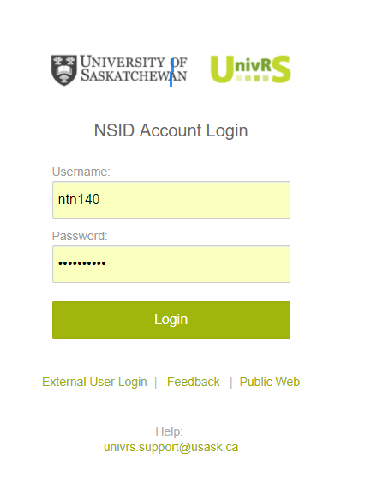
Submitting Discovery/RTI Applications
Discovery Grant applications must be submitted via UnivRS for Review and Approval
Submit a copy of your complete Discovery application, including your CCV for review and approval.
RASI Internal Deadline for review and approval is
RTI – Oct 18th
Discovery Grant - Oct 25th
Check with your Department/College to find out how many days they need for review and approval.
Application should be submitted in UnivRS 7-10 days before the agency deadline.
UnivRS – University Research System
Contact your Facilitator or Research Support Specialist for help with submitting your application in UnivRS.

Slide 40
Compliance Review
Your application will be reviewed to ensure it meets the agency requirements and follows Usask policies.
Research Support Specialist reviews your application and sends you feedback from the review.
Wait until you receive feedback and make your final revisions before submitting your application in the Research Portal.
Research Support Specialist | Email
Nicole Benning | nicole.benning@usask.ca
Cameron Berg | cam.berg@usask.ca
Brenda Meyer-Burt | brenda.meyer-burt@usask.ca
Centaine Raginski | centaine.raginski@usask.ca
Laurie Schmipf | laurie.Schimpf@usask.ca
Gerelt Trost | gerelt.trost@usask.ca

Slide 41
Common Compliance Issues
Don’t include demographic data in the Equity, Diversity and Inclusion sections of your application.
Use the headings and sub-headings provided for the free-form sections.
Provide details such as the rates for benefits, fees, per diem, mileage, rental, housing, etc. in your budget justification.
Follow the Research portal presentation and attachment standards.
Provide an explanation for all other research support that will be or may be active during the funding period of the Discovery Grant.
Update your CCV including the Research Funding History.

Slide 42
Some useful links:
NSERC guidelines for Impacts of the COVID-19 pandemic on research:
https://www.nserc-crsng.gc.ca/NSERC-CRSNG/Policies-Politiques/COVID-COVID_eng.asp
Equity, diversity and inclusion considerations at each stage of the research process:
https://www.nserc-crsng.gc.ca/NSERC-CRSNG/Policies-Politiques/EDI_guidance-Conseils_EDI_eng.asp
NSERC DG and RTI Evaluation Groups:
https://www.nserc-crsng.gc.ca/NSERC-CRSNG/committees-comites/programs-programmes_eng.asp
Grant Repository:
https://usaskca1.sharepoint.com/sites/GrantsRepository

Slide 43
Q & A

