Slide 1
NSERC Discovery Grant and RTI Workshop 2020 Session 1 September 10, 1:30 pm – 3:00 pm

Slide 2
Addressing EDI in NSERC DG
www.usask.ca

Slide 3
Tri-Agency Statement on Equity, Diversity and Inclusion (EDI)
Support and promote equitable access to funding and training opportunities.

Slide 4
Typically shows up in three places
Research design
Ensuring those who can benefit from the research have equal access to participate and receive the benefits and that no single group bares more of the risk
Team
Refers to your co-investigators, collaborators, etc. Those who will help design and execute the research and mentor trainees
Training
Actions you will take to ensure equitable access to research training and promote a culture of EDI in research

Slide 5
HQP Training Plan
Training philosophy
Barriers or challenges in your area
Identify what some of the challenges are to recruiting and retaining EDI trainees
Actions you will take to promote and support participation of diverse HQP in research:
Inclusive recruitment practices
Equitable access to mentorship
Promote trainee growth
Remove barriers to participation

Slide 6
Examples
Indicate that:
You will work with your HR and admin. support to ensure HQP recruitment practices are inclusive
You have participated in EDI or unconscious bias training
You will discuss EDI concepts with your trainees and encourage them to participate in EDI and unconscious bias training and other opportunities to learn about EDI, including organizations like Women in Engineering.
You will give consideration to issues such as family care and other barriers to ensure all trainees have equitable access to opportunities such as conference travel and field work, as well as mentorship.
You will ensure all of your trainees are aware of resources such as USask Access and Equity Services and their programs and services.

Slide 7
Past Contributions to training of HQP
Describe specific actions you have taken to support EDI (similar as above)
DO NOT include demographic information of your trainees
NSERC does not request or require this data
This will be insufficient alone to answer the requirements

Slide 8
Most significant contributions
Impact may include ways in which you contributed to increased EDI in research.

Slide 9
Proposal: Methodology
inclusion of sex (biological), gender (socio-cultural) and diversity considerations in research design
If results of your research could be influenced by or could have different impacts on different groups, this must be accounted for in the research design.
This may not apply to your research, but if it is at all ambiguous, provide a justification for why it does not apply.

Slide 10
Resources
USask EDI Sharepoint: https://usaskca1-my.sharepoint.com/:b:/r/personal/maj944_usask_ca/Documents/NSERC/EDI%20RESOURCES/Combined%20Resource-%20ERIN%20and%20SRI/EDI%20Resources%20for%20NSERC%20DG%20applicants.pdf?csf=1&web=1&e=U3kpY3
Balance and Belonging Speaker Series + Certificate of Attendance
CRC Unconscious Bias Training Module:
NSERC Guide for Applicants: Considering EDI in your application: https://www.nserc-crsng.gc.ca/_doc/EDI/Guide_for_Applicants_EN.pdf

Slide 11
Compliance Review And UnivRS

Slide 12
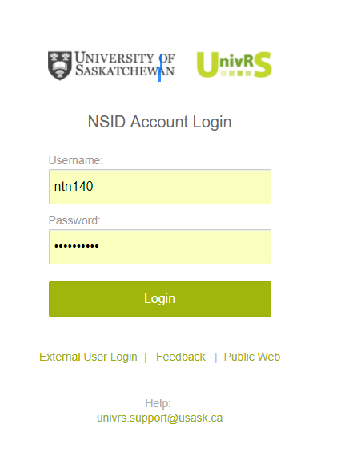
Submitting Discovery Application
Discovery Grant applications must be submitted via UnivRS for Review and Approval
Submit a copy of your complete Discovery application, including your CCV for review and approval.
RASI Internal Deadline for review and approval is Oct 26th.
Check with your Department/College to find out how many days they need for review and approval.
Application should be submitted in UnivRS 7-10 days before the agency deadline.
UnivRS – University Research System
Contact your Facilitator or Research Support Specialist for help with submitting your application in UnivRS.

Slide 13
Compliance Review
Your application will be reviewed to ensure it meets the agency requirements and follows Usask policies.
Research Support Specialist reviews your application and sends you feedback from the review.
Wait until you receive feedback and make your final revisions before submitting your application in the Research Portal.
Research Support Specialist | Email
Ronda Appell | ronda.appell@usask.ca
Nicole Benning | nicole.benning@usask.ca
Cameron Berg | cam.berg@usask.ca
Tera Ebach | tera.ebach@usask.ca
Brenda Meyer-Burt | brenda.meyer-burt@usask.ca

Slide 14
Common Compliance Issues
Equity, Diversity and Inclusion is a very important part of your application and should be considered and addressed in your application.
Provide details such as the rates for benefits, fees, per diem, mileage, rental, housing, etc. in your budget justification.
Follow the Research portal presentation and attachment standards.
Provide an explanation for all other research support that will be or may be active during the funding period of the Discovery Grant.
Update your CCV including the Research Funding History.

Slide 15
Links to Some Useful Resources

Slide 16
NSERC DG and RTI Workshop – 2020 List of Resources
Slides from Previous Workshop:
https://vpresearch.usask.ca/documents/research-process/research-facilitation/workshops/2019-05-21-nserc-grants-workshop-slides.pdf.pdf
Video from 2019 workshop
https://usaskca1-my.sharepoint.com/:v:/g/personal/maj944_usask_ca/Ea0QIPhYwitGs_Zl3xtjI5oBQcl48CB_wTs4XAbJqZCOoA?e=k3ekTe
Peer Review Manuals for DG and RTI
https://www.nserc-crsng.gc.ca/_doc/Reviewers-Examinateurs/CompleteManual-ManualEvalComplet_eng.pdf
https://www.nserc-crsng.gc.ca/_doc/Reviewers-Examinateurs/RTI-OIR_eng.pdf

Slide 17
NSERC DG and RTI Workshop – 2020 List of Resources
For DG/RTI timeline with updated information on DG and RTI webinars click here
Successful grant examples on the USask Grants repository:
https://share.usask.ca/go/ovpr/grants_repository/Pages/NSERC-Examples.aspx
Resources for EDI component of your Discovery Grant application:
https://usaskca-Equity Diversity and Inclusion Resources

