Slide 1
Spring 2025 CIHR Project Grant Workshop and Panel Q&A Manisha Jalla Research Development Specialist, Office of Vice President Research January 22, 2025; 1:30 – 3:00 pm HLTH 1130 (E-wing), Health Science Building

Slide 2
Land Acknowledgement
As we gather here today, we acknowledge we are on Treaty 6 Territory and the Homeland of the Métis. We pay our respect to the First Nations and Métis ancestors of this place and reaffirm our relationship with one another.

Slide 3
USask Project Grant Results 2019-2024
 | Spring 2019 | Fall 2019 | Spring 2020 | Fall 2020 | Spring 2021 | Fall 2021 | Spring 2022 | Fall 2022 | Spring 2023 | Fall 2023 | Spring 2024
Overall CIHR Award ($) | 276,424,907 | 282,219,435 | 254,719,262 | 283,743,584 | 325,000,000 | 325,000,000 | 325,000,000 | 325,000,000 | 325,000,000 | 325,000,000 | 325,000,000
USask CIHR Award ($) | 1,847,475 | 3,205,351 | 3,262,296 | 1,875,781 | 4,453,402 | 4,145,226 | 4,061,076 | 1,852,140 | 7,184,452 | 4,862,701 | 3,811,352
USask of National (%) | 0.7 | 1.1 | 1.3 | 0.7 | 1.4 | 1.3 | 1.3 | 0.6 | 2.2 | 1.5 | 1.1
Rank - U15 | 15 | 14 | 14 | 14 | 13 | 15 | 12 | 15 | 3 | 1
# USask Application | 30 | 29 | 30 | 39 | 30 | 31 | 33 | 32 | 36 | 31 | 31
USask of National (%) | 1.2 | 1.3 | 1.4 | 1.7 | 1.3 | 1.5 | 1.6 | 1.7 | 1.7 | 1.4 | 1.2
National Success (%) | 17.1 | 21.3 | 16.9 | 19.1 | 20.4 | 25.9 | 22 | 35 | 21.5 | 24.3 | 18.05
USask Success (%) | 10.0 | 13.8 | 20.0 | 7.7 | 20.0 | 19.3 | 21 | 18.8 | 25 | 41.9 | 22.58
Underwent IR (%) | 54 | 86 | 50 | 62 | 70 | 48 | 51 | 59 | 53 | 51 | 64
Awarded IR (%) | 75 (3/4) | 67 (2/3) | 83 (5/6) | 67 (2/3) | 100(6/6) | 17(1/6) | 71(5/7) | 33(2/6) | 56(5/9) | 46(6/13) | 71(5/7)

Slide 4
CIHR Project Grant Competition
University of Saskatchewan has been making steady progress on CIHR Project Grant accomplishment
We’ve made gains in CIHR Project Grant funding success
2010 to 2015 (6 years): USask had 26 applications/competition with a funding success rate of 10% (compared to 17% nationally)
2016 to 2021 (6 years): USask had 33/competition with a funding success rate of 15% (compared to 17% nationally)
2022 to 2023 (2 years): USask had 33/competition with a funding success rate of 27% (compared to 26% nationally)
….and for the most recent Spring 2024 competition (22.58% compared to 18.05% nationally) we had 8 unsuccessful applications with scores ≥4.0
USask was ranked #3 and #1 [funding success] in U15 for Spring and Fall 2023 competitions respectively
USask was awarded more than $12M in Project Grant funding in calendar year 2023 – the most in our institution’s history
Concerted efforts to elevate success (to at least match national average) have yielded results ie. CIHR Task Force, CIHR Oversight Workgroup

Slide 5
Project Grant Funding Awarded – U15

Slide 6
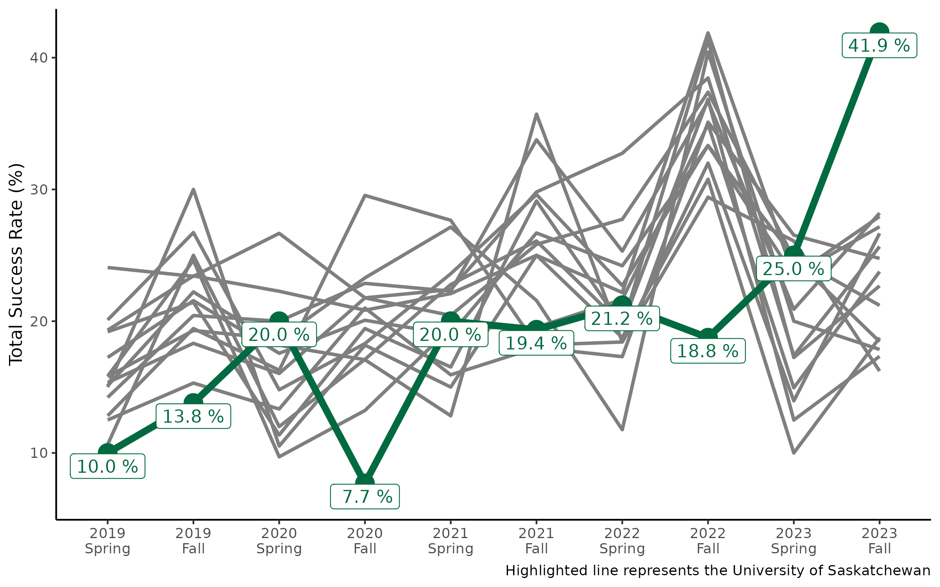
Project Grant Application Success – U15

Slide 7
Fall 2023 and Spring 2024 Results: Highlights
62 (31+31) applications were submitted and 20 were funded
USask Success Rate: 41.9% (Fall 2023); National Success Rate: 24.3%
22.5% (Spring 2024); National Success Rate: 18.05%
Total funds awarded were $8.67M
29 received scores of 4.0 and above
While 2 ECRs got their Project Grants in 1st attempt;
2 successful applications were the 3rd attempt; 2 were 4th attempt and 3 were 9th/10th attempts. Persistence, refining and re-application is the key…….

Slide 8
CIHR Bridge Funding Program
Supports faculty who receive a high PG score/ranking, but were not funded, in re-applying (must undergo Internal Review to be eligible)
18 applicants funded to date – year 5 of operation
‘A Priori’ evaluation outcomes:
Did they re-apply? 16/17 (94%) bridge funding recipients reapplied
Did score/ranking increase? 12/16 (75%) score/ranking increased
Was application funded by CIHR? 11/16 (68.75%) reapplied and were awarded Project Grant by CIHR
$160k/year for the spring & fall PG competitions
OVPR ($80k/yr) and Medicine, WCVM, Pharmacy & Nutrition, Nursing, Kinesiology, Dentistry, Engineering, Arts & Science
VIDO recently joined the pool of contributing colleges

Slide 9
College of Reviewers
College of Reviewers - recruitment
2017: 10 members 2024: 88 members
22 USask members recognized by CIHR for ‘Outstanding Performance’ as reviewers for the Fall and/or Spring Project Grant Competitions since 2021 (honour limited to a select number of reviewers - 19.9% of all reviewers - who demonstrate exemplary commitment to peer review)
This ongoing engagement and dedication is significant to USask, as it continues to both strengthen our institution’s representation at Tri-Council and contribute more meaningfully to their programs
If you are interested in becoming a Member of the College or would like to nominate a candidate for consideration, you are encouraged you to complete online Nomination form
College of Reviewers - CIHR (cihr-irsc.gc.ca)
RiT program Reviewer in Training Program - CIHR (cihr-irsc.gc.ca)

Slide 10
Update to Notice of Recommendation and Notice of Decision templates for the Project Grant competition
Update to Notice of Recommendation and Notice of Decision templates for the Project Grant competition: Message from the Vice-President and Associate Vice-President, Research Programs (Operations) – CIHR
Applicants not see their specific ranking
Will be able to see the zone in which their application ranks:
in the bottom 25%,
between 25% and 50%,
between 50% and 75%,
between 75% and 90%,
or 90% and above

Slide 11
Internal Review
Goal is to provide high quality feedback to researchers during the final stages of grant
development.
NOI and timelines are available on USask Tri Agency website
Contact: grant.review@usask.ca / Manisha.jalla@usask.ca
IMPORTANT DATES/DEADLINES | NEW APPLICATION | RESUBMISSION (applications that were submitted to the Fall 2024 competition)
NOI Due | December 12, 2024 | February 4, 2025
Draft Application Due | January 27, 2025 | February 10, 2025
Internal Reviews returned to applicants | February 20, 2025 | February 24, 2025
CIHR Registration Deadline | February 5, 2025
Compliance Review Deadline (UnivRS) | February 26, 2025
CIHR Application Deadline | March 5, 2025

Slide 12
Amplified Internal Review for Project Grant
New and Amplified Process launched Fall 2023
USask Council of Strategic Grant Advisors
More rigour and depth, and support for applicants
Applicants will have an early opportunity to obtain research support, longitudinal guidance/advice, and feedback on their proposal
Some targeted supports for high-ranking project grant applications
Newly constituted as part of the amplified process
Currently council has 58 SGAs
Key CIHR researchers from across USask spanning a breadth of health research, leading research programs and with extensive peer review experience, nationally
Faculty Availing Support: Program Participants
Currently 13 faculty have registered for the amplified program
Paired with SGAs who have relevant background and expertise

Slide 13
Amplified Review Program: Supports Available
Strategic Grant Advisors
CIHR Grant Holder
Peer Review Committee Member
Work with applicants up to submission (resubmission)
Support individualized to applicants
Grant Facilitation Team
Strategic Grant Advisors
A/V Dean Research
Research Facilitator
Targeted support ($$) for High Potential Applications
High Ranking Applications
Limited Funding available
Grant Writing/Polishing, Meetings etc

Slide 14
Amplified Internal Review for Project Grant contd..
Currently NOIs for the amplified review program are being accepted for Fall 2025 (or onwards competition)
If you’d like to work with a Strategic Grant Advisor and avail supports offered through this program
NOI form and more details are available on USask Tri agency website

Slide 15
USask CIHR Bridge Funding
CIHR Project Grant Bridge Funding Program supports USask faculty who received a high score/ranking in the Project Grant competition, but were not funded, in
re-applying for CIHR funding.
Up to four (4) bridge funding awards of $20k or two (2) awards of $40K will be
available for the Fall Project Grant 2024 competition
Guidelines and Application form are available on the website (see under CIHR Internal Funding tab)
NOTE: Applications must have undergone formal USask CIHR Internal Review
Contact: cihr.bridgefunding@usask.ca / Manisha.jalla@usask.ca

Slide 16
CIHR Project Grant Resources Available
Slides from previous workshops
Tri-Agency Research Support - Office of the Vice President Research - Research | University of Saskatchewan (usask.ca)
Successful CIHR grant examples on the USask Grants repository https://share.usask.ca/go/ovpr/grants_repository/Pages/CIHR- Examples.aspx
Grant deadlines, internal review and workshop information is distributed through triagency.leaders@usask.ca (dedicated for TriAgency communication) via the CIHR Research Listserv Health Sciences/CIHR/SHRF

Slide 17
For more information, please contact:
Manisha Jalla, Research Development Specialist Manisha.jalla@usask.ca
Internal Review grant.review@usask.ca
CIHR Bridge Funding cihr.bridgefunding@usask.ca

Slide 18
Thank-you!
Questions…?
…Comments?

